Slide 1
Morris Brandon GO Team Business Meeting #3
11/13/25

Slide 2

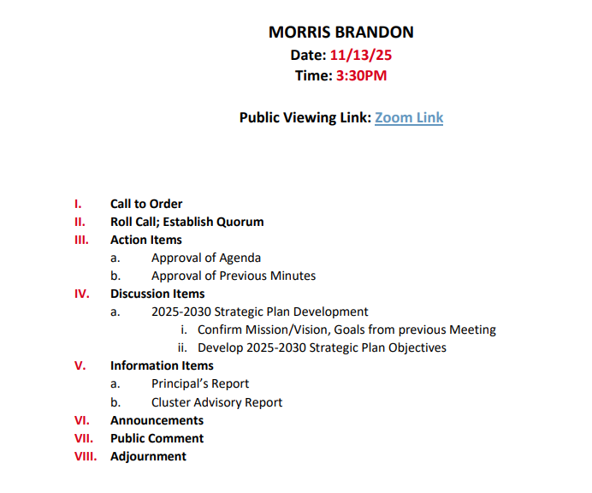
Agenda

Slide 3

Action Items
Approval of Agenda
Approval of Previous Minutes
Additional Action Item (if needed)

Slide 4
Discussion Items

Slide 5
Continuing the 2025-2030 School Strategic Plan Development Process

Slide 6
School Strategic Planning Overview
Purpose
To cascade the district strategic plan to the school level, while grounding our focus in the school’s Continuous Improvement Plan. This will create alignment, reduce confusion, and simplify our efforts.
Timeline
Our school’s 2030 Strategic Goals and Objectives should be updated, approved and ranked by January 2026. Schools will focus on the strategies as part of FY27 Budget and Continuous Improvement Plan processes.

Slide 7
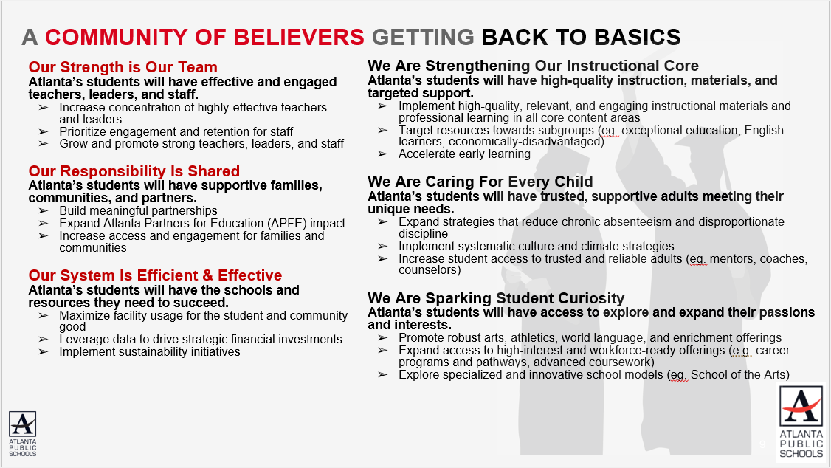
Atlanta Public Schools’ 2025-2030 Strategic Plan

Slide 8
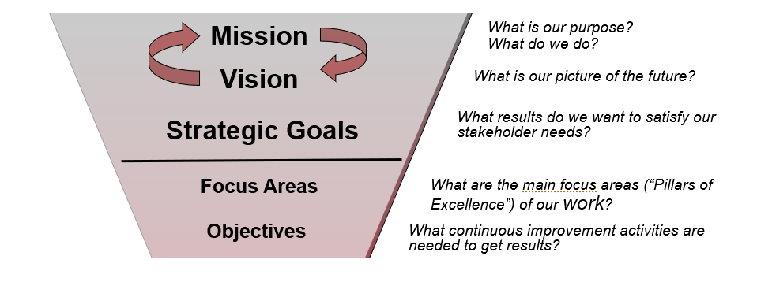
GO Team’s Focus (Governance)

Slide 9

School Strategic Planning Process Overview
1
Review Data
Sample GO Team Business Meeting Cadence
Business Meeting 1:
Review Data (MAP, GMAS, Graduation Rate, CCRPI, etc.)
Business Meeting 2:
Review Data (School KPIs)
Align Mission/Vision/ Purpose
Confirm 2030 Goals
Business Meeting 3:
Identify 2025-2030 Strategic Objectives
Business Meeting 4 (Budget Allocation):
Approve Your Strategic Plan & Rank Your Strategic Objectives for FY27
2
Align Mission/Vision/Purpose
3
Confirm 2030 Goals
Create CIP Goals to 2030
Identify Additional Goals
4
Identify 2025-2030 Strategic Objectives
Reflect on 2020-2025 Strategic Plan
Review and Discuss Additional Objectives Going Forward
5
Approve Your Strategic Plan & Rank Your Strategic Objectives for FY27

Slide 10
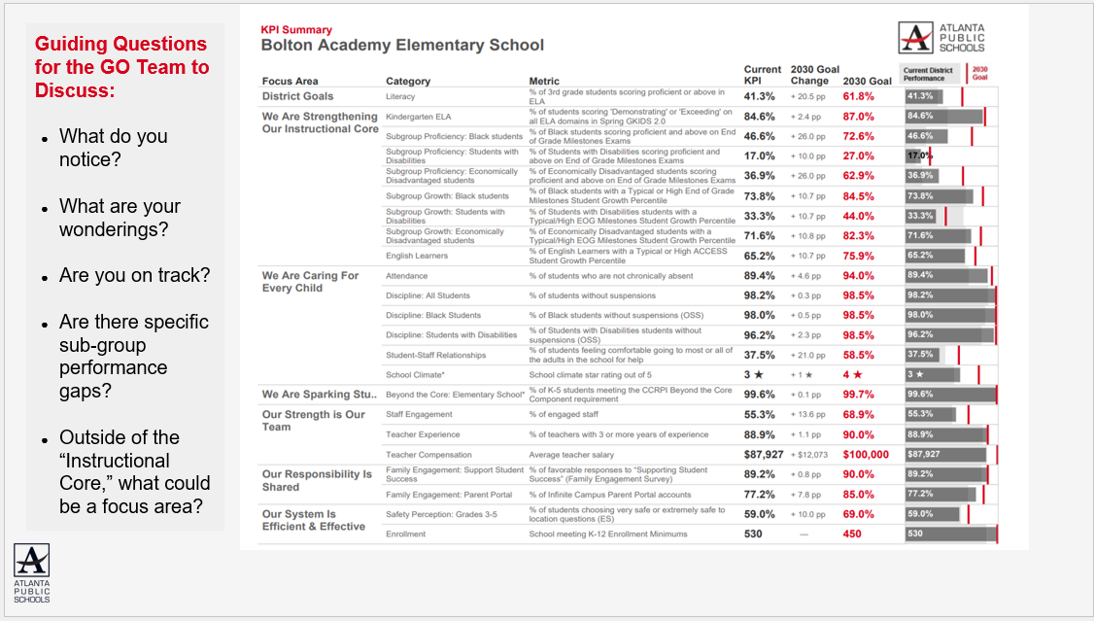
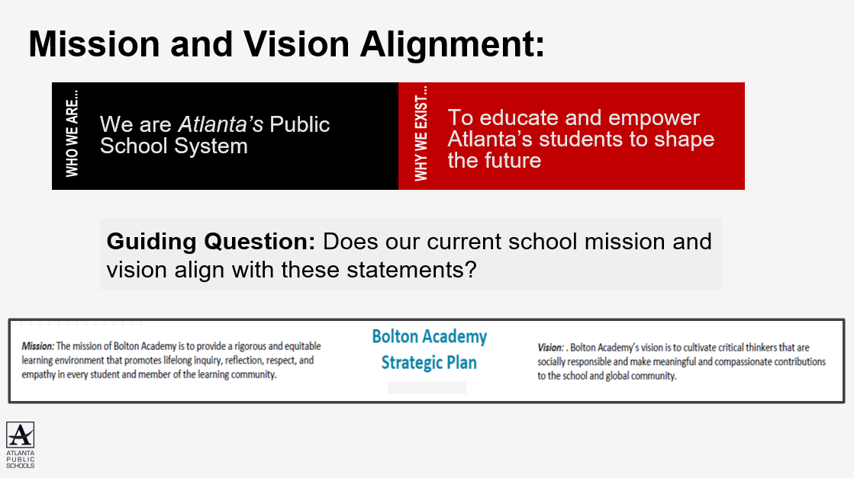
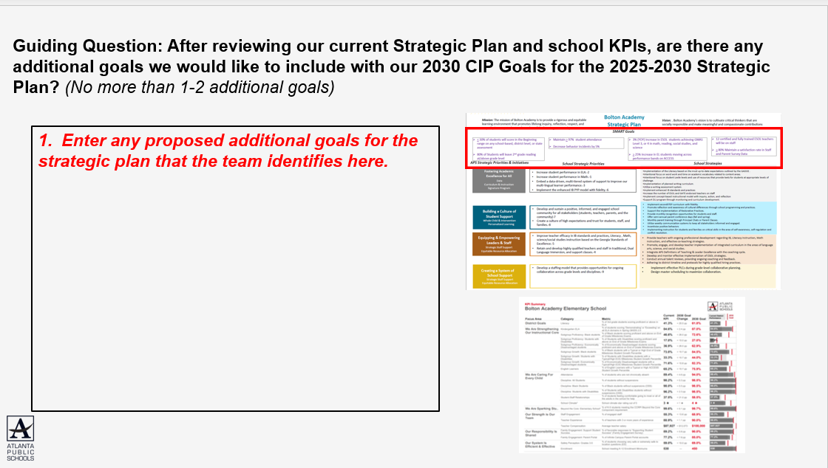
In Our Last Meeting We…
1
Reviewed Our
School Data
2
Aligned Our
Mission and Vision
3
Confirmed Our
2030 Goals

Slide 11
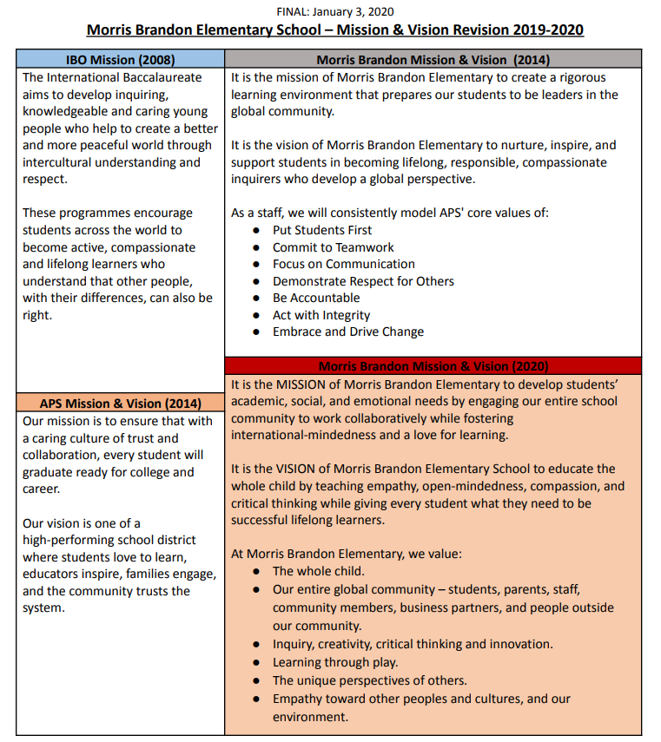
Mission and Vision Alignment (revised):

Slide 12
Continuous Improvement Goals
1
By the end of the 2025–2026 school year, the percentage of students scoring Proficient or Distinguished levels in Math on the Georgia Milestones from 72%-80%.
2
By the end of the 2025–2026 school year, the percentage of students scoring Proficient or Distinguished levels in ELA on the Georgia Milestones from 74%-80%.
3
By the end of the 2025–2026 school year, 100% of new 1st–5th grade students at Brandon will be connected to the school community, as evidenced by 95% or higher attendance and zero or reduced office discipline referrals for each student.
2030 Strategic Plan Goals
1
By 2030, increase the percentage of 3rd grade students scoring proficient or above in ELA from 76.5% to 87%.
2
By 2030, increase the percentage of Black students with typical or high end of grade milestone student growth percentiles from 62.5% to 73.2%.
3
By 2030, increase the percentage of students feeling comfortable going to most or all of the adults in the school for help from 54.2% to 75.2%.
4
By 2030, increase the percentage of engaged staff from 64.3 to 77%.

Slide 13

Today’s Focus:
School Strategic Planning Process: Step 4
1
Sample GO Team Business Meeting Cadence
Business Meeting 1:
Review Data (MAP, GMAS, Graduation Rate, CCRPI, etc.)
Business Meeting 2:
Review Data (School KPIs)
Align Mission/Vision/ Purpose
Confirm 2030 Goals
Business Meeting 3:
Identify 2025-2030 Strategic Objectives
Business Meeting 4 (Budget Allocation):
Approve Your Strategic Plan & Rank Your Strategic Objectives for FY27
Review Data
2
Align Mission/Vision/Purpose
3
Confirm 2030 Goals
Create CIP Goals to 2030
Identify Additional Goals
4
Identify 2025-2030 Strategic Objectives
Reflect on 2020-2025 Strategic Plan
Review and Discuss Additional Objectives Going Forward
5
Approve Your Strategic Plan & Rank Your Strategic Objectives for FY27

Slide 14
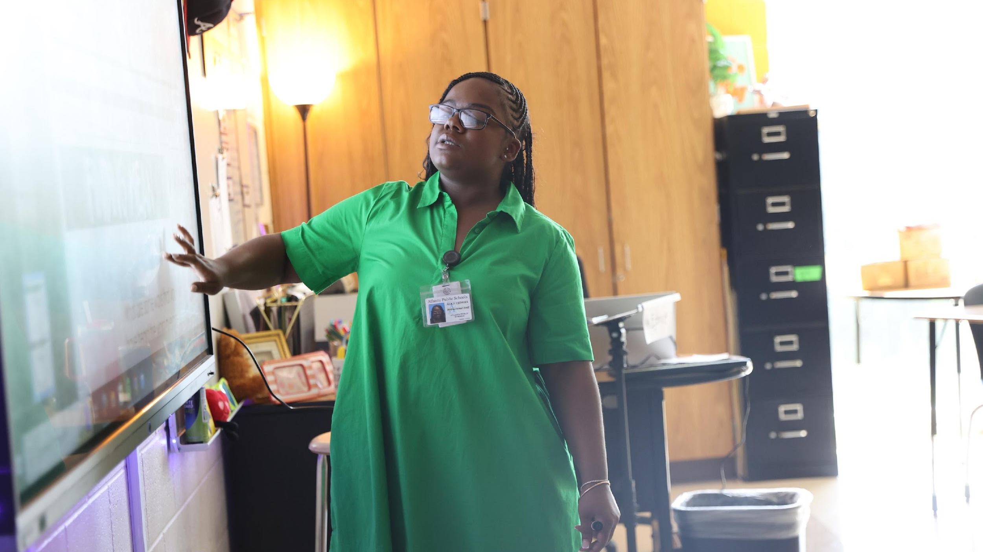

4. Identify 2025-2030 Strategic Objectives
Reflect on 2020-2025 Strategic Plan (Stop, Continue)
Review and Discuss Additional Objectives Going Forward
(Start)
One District. One Goal. Every Child.

Slide 15
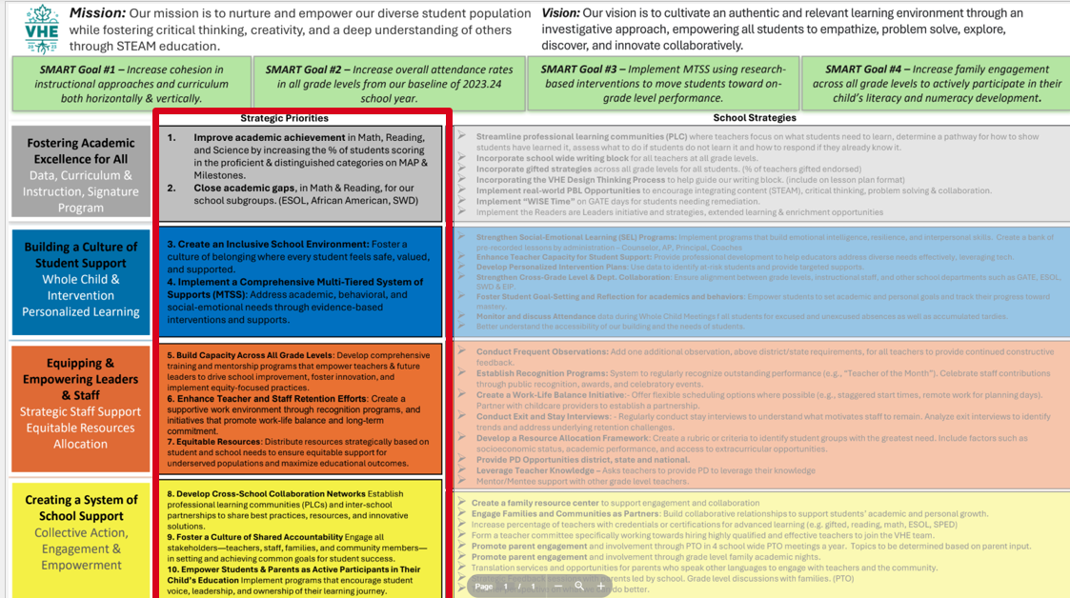
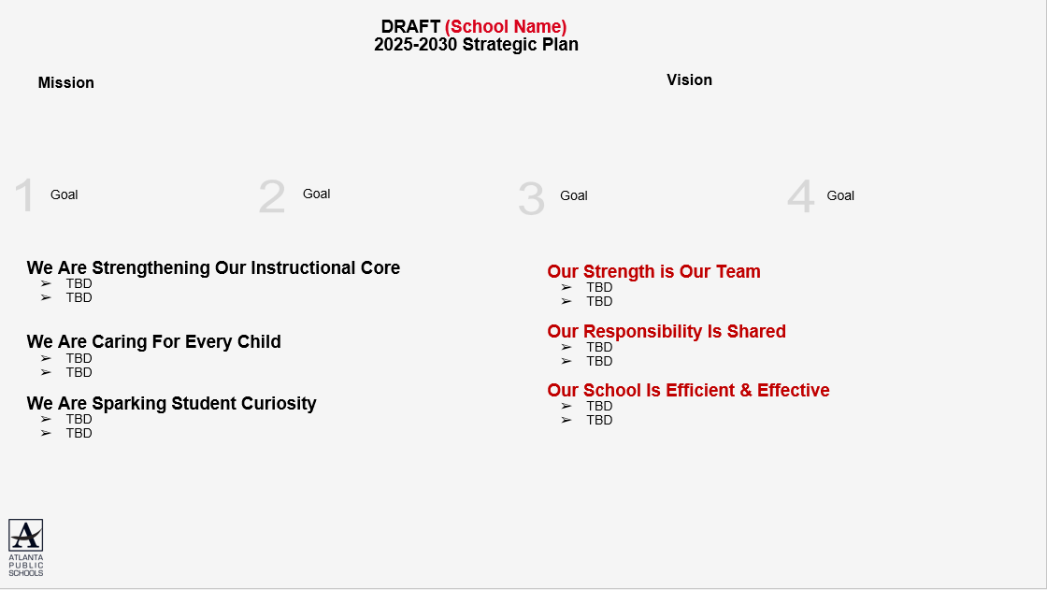
4
Using our new, 2025-2030 Strategic Goals as a guide we will complete a Start, Stop and Continue exercise to review our current “Strategic Priorities” and identify our 2025-2030 Strategic Objectives

Slide 16
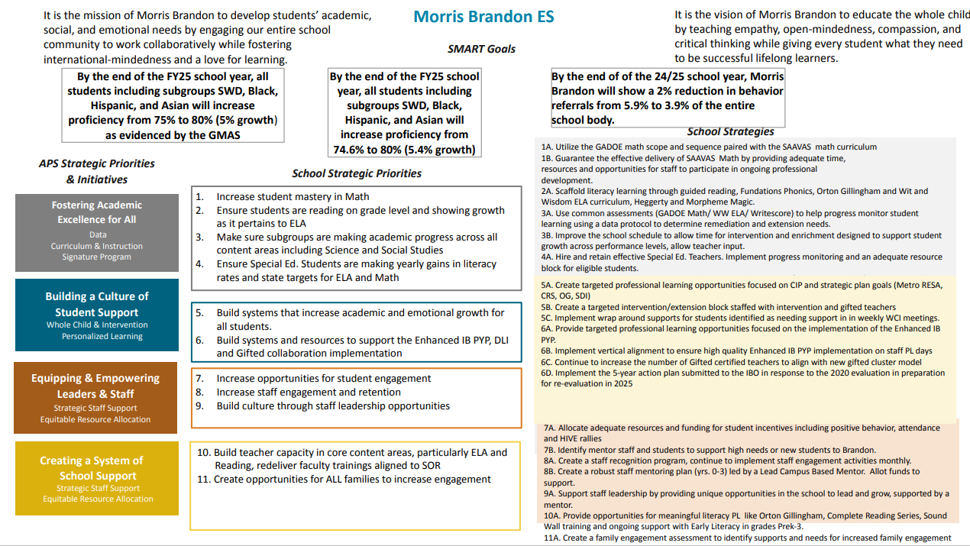

Slide 17

Identifying 2025-2030 Strategic Objectives: Continue Discussion
FOSTERING ACADEMICS FOR ALL (CONTINUE):
“Ensure students are reading on grade level and showing growth as it pertains to ELA”.
“Make sure sub groups are making academic progress across all content areas”
“Ensure Exceptional Education students are making yearly gains in literacy rates and state targets for ELA and math”

Slide 18
Identifying 2025-2030 Strategic Objectives: Continue Discussion
BUILDING A CULTURE OF STUDENT SUPPORT (CONTINUE):
“Make sure subgroups are making academic progress across all content areas including science and social studies”
“Build systems and resources to support the Enhanced IB PYP, DLI and gifted collaboration”

Slide 19
Identifying 2025-2030 Strategic Objectives: Continue Discussion
EQUIPPING AND EMPOWERING LEADERS AND STAFF (CONTINUE):
“Increase opportunities for student engagement”

Slide 20
Identifying 2025-2030 Strategic Objectives: Continue Discussion
CREATING A SYSTEM OF SCHOOL SUPPORT (CONTINUE):
“Increase (opportunities for) staff engagement and retention”
“Create opportunities for all families to increase engagement”

Slide 21
Once you have completed the “Stop” and “Continue,” discussions please move the “Continue” Objectives (previously Priorities) to the appropriate “Focus Area.”
Fostering Academic Excellence for All is likely aligned to “We Are Strengthening Our Instructional Core” or “We Are Sparking Student Curiosity”
Building a Culture of Student Support is likely aligned to “We Are Caring For Every Child”
Equipping & Empowering Leaders & Staff is likely aligned to “Our Strength is Our Team”
Creating a System of School Support is likely aligned to “Our Responsibility is Shared” or “Our School is Efficient & Effective”
“Community of Believers”
“Getting Back to Basics”
Our Strength is Our Team
Increase opportunities for student engagement
Increase (opportunities for) staff engagement and retention
Our Responsibility Is Shared
Create opportunities for all families to increase engagement
TBD- Strategic Objective
Our School Is Efficient & Effective
TBD- Strategic Objective
TBD- Strategic Objective
We Are Strengthening Our Instructional Core
Ensure students are reading on grade level and showing growth as it pertains to ELA
Make sure sub groups are making academic progress across all content areas
We Are Caring For Every Child
Ensure Exceptional Education students are making yearly gains in literacy rates and state targets for ELA and math
TBD- Strategic Objective
We Are Sparking Student Curiosity
Build systems and resources to support the Enhanced IB PYP, DLI and gifted collaboration
TBD- Strategic Objective

Slide 22
Identifying 2025-2030 Strategic Objectives: “Start” Discussion
After you have moved your Objectives to the appropriate Focus Area, identify any new Objectives the school must implement to address the goals
Focus on the “Getting Back to Basics” Focus Areas first (Strengthening Our Instructional Core, Caring For Every Child, and Sparking Student Curiosity)
Make sure you have something in the “Community of Believers” Focus Areas that support your core work (Strength is Our Team, Responsibility is Shared, System is Effective & Efficient)

Slide 23
Atlanta Public Schools’ 2025-2030 Strategic Plan

Slide 24
Identifying 2025-2030 Strategic Objectives: Continue Discussion
START
Our Responsibility Is Shared
Create opportunities for all families to increase engagement
TBD- Strategic Objective
Create opportunities to partner with universities in the metro area

Slide 25
Identifying 2025-2030 Strategic Objectives: Continue Discussion
START
Our School Is Efficient & Effective
TBD- Strategic Objective
TBD- Strategic Objective
leverage school finances to (local/federal/private) to help close achievement by ensuring resources are allocated to students that need them.
Working to ensure class sizes are efficient and effective to maximize student learning

Slide 26
Identifying 2025-2030 Strategic Objectives: Continue Discussion
START
We Are Caring For Every Child
Ensure Exceptional Education students are making yearly gains in literacy rates and state targets for ELA and math
TBD- Strategic Objective
Student health survey (Trusted adult)
Add ED students (need % growth/ proficiency)

Slide 27
Identifying 2025-2030 Strategic Objectives: Continue Discussion
START
We Are Sparking Student Curiosity
Build systems and resources to support the Enhanced IB PYP, DLI and gifted collaboration
TBD- Strategic Objective
Find a way to leverage our SPECIALISTS (PAM/ Foreign language, ODIE, counseling, innovation lab)
Ideas for community based mentoring programs (Ingram)

Slide 28
Where we’re going
At our next meeting we will:
Vote on the 2025-2030 Strategic Plan
Rank our 2025-2030 Strategic Objectives
Begin the discussion of the 2026-2027 budget
Let me or the Chair know of any additional information you need for our future discussion.

Slide 29

Questions?

Slide 30
Information Items

Slide 31
PUBLIC COMMENT

Slide 32
Announcements

Slide 33
Thank you

Slide 34
DRAFT (School Name)
2025-2030 Strategic Plan Template
Mission
Vision
1
Strategic Goal
2
Strategic Goal
3
Strategic Goal
4
Strategic Goal
We Are Strengthening Our Instructional Core
TBD- Strategic Objective
TBD- Strategic Objective
We Are Caring For Every Child
TBD- Strategic Objective
TBD- Strategic Objective
We Are Sparking Student Curiosity
TBD- Strategic Objective
TBD- Strategic Objective
Our Strength is Our Team
TBD- Strategic Objective
TBD- Strategic Objective
Our Responsibility Is Shared
TBD- Strategic Objective
TBD- Strategic Objective
Our School Is Efficient & Effective
TBD- Strategic Objective
TBD- Strategic Objective

