Slide 1




GO Team Organizational Meeting
8/20/26 @ 3:00pm

Slide 2


Slide 3
Agenda
Call to Order
Roll Call; Establish Quorum
Action Items
  Approval of Agenda
  Fill Vacant Positions (
  Fill Open Community Member Seat
  For High Schools: Appoint Student Representatives
  Approval of Previous Minutes
  Election of Officers and Representatives
    Chair
    Vice-Chair
    Secretary
    Cluster Representative
  Set GO Team Meeting Calendar
  Review and Approve Public Comment Protocol
  Review, Confirm/Update, and Adopt GO Team Meeting Norms
Discussion Items
  Stakeholder Engagement Exercise
Information Items
  Principal’s Update
    APS Personal Electronic Device Policy (PED)
    Our PED Implementation
Announcements
  New GO Team Member Training and Orientation
Adjournment
Notes:
Call to Order
MEETING LEADER- PRINCIPAL – INTERIM CHAIR
[NOTE: The principal may act as Chair for this meeting ONLY.]
Good Morning/Afternoon/Evening. Welcome to [insert school’s name] GO Team Meeting, where we will follow the agenda as it has been emailed to you and publicly noticed.
I am pleased to call this meeting of the [insert school’s name] GO Team to order at [insert current time]. I will act in the capacity of interim GO Team Chair for this meeting.
Our first order of business is to appoint an interim secretary and call roll. [insert name of appointed interim secretary] will serve as the interim secretary only for this meeting. Our official secretary for the 2026-2026 school year will be elected during this meeting. The interim secretary will now take the roll.

Slide 4
Meeting Opening:
Interim Secretary
Call Roll
Establish Quorum
GO Team will appoint an interim secretary for this meeting.
Interim Secretary will call roll of current GO Team members.
Secretary will announce if the GO Team has a quorum.
The meeting can only proceed if a majority of current members are present.
Notes:
Our first order of business is to appoint an interim secretary and call roll. [insert name of appointed interim secretary] will serve as the interim secretary only for this meeting. Our official secretary for the 2026-2026 school year will be elected during this meeting. The interim secretary will now take the roll.
SECRETARY
Please respond “Present” when your name is called.
[Calls roll of GO Team members and records responses and absences in the minutes.]
PRINCIPAL - INTERIM CHAIR
This team will only be able to take official action if a quorum is present. [insert name of appointed interim secretary], is there a quorum present?
SECRETARY
“YES, there is a quorum present.” OR “No, there is not a quorum present.”
PRINCIPAL - INTERIM CHAIR
If there is NO quorum present: We do not have a quorum present. We needed a majority of GO Team members in attendance to vote on the agenda items. Having a quorum protects the school by preventing a very small number of members from taking action on behalf of the entire school. We will proceed with today’s information items. Discussion and action items will be tabled until a quorum is established. We will need to reschedule this meeting.
If there is a quorum present, proceed to Action Items

Slide 5
Approve the Agenda
Call to Order
Roll Call; Establish Quorum
Action Items
  Approval of Agenda
  Fill Vacant Positions
  Fill Open Community Member Seat
  For High Schools: Appoint Student Representatives
  Approval of Previous Minutes Election of Officers and Representatives
    Chair
    Vice-Chair
    Secretary
    Cluster Representative
  Set GO Team Meeting Calendar
  Review and Approve Public Comment Protocol
  Review, Confirm/Update, and Adopt GO Team Meeting Norms
Discussion Items
  Stakeholder Engagement Exercise
Information Items
  Principal’s Update
    APS Personal Electronic Device Policy (PED)
    Our PED Implementation
Announcements
  New GO Team Member Training and Orientation
Adjournment
Notes:
Approval of the Agenda
PRINCIPAL - INTERIM CHAIR
Our first order of business is to Approve the Agenda. This was provided to you and copies are here.
May I have a motion to Approve the Agenda? A second? Are there any amendments to the agenda? [Amendments are made through a motion, second, and voting; if there is general consensus, all offered changes made be made as one motion. If there is not consensus for all changes, then each change should be voted on separately.]
All in favor, please say aye or raise your hand so the secretary can record your vote. All opposed, please say nay or raise your hand. Any abstentions? Please say abstain or raise your hand. [The secretary will note who made the motion, who seconded, and how each member voted.]
We will now move to Filling Vacant Seats, and the Open Community Member seat. Before we begin the process, I’d like to remind the GO Team of the following:
The Principal brings forth the nominations for the vacant and open community seats,
All GO Team members have only one (1) vote per seat.
Individuals filling a vacant seat will serve until the conclusion of that seat’s term.
Individuals filling an open seat will serve for the full two-year term.
Upon approval, individuals are immediately full GO Team members and may join the meeting.

Slide 6
Fill Open Community Seat 9/17 with GOTeam Feedback
The new Community Member for the open seat will serve for a full two-year term – until June 2027.
Individuals cannot be full-time APS employees.
Principal nominates the individual for the Community Member seat.
The GO Team votes on the nomination for the Community Member.
Notes:
We will now move to fill the Open Community Member Seat. This person will serve on the GO Team for a full two-year term.
I nominate [insert nominee’s name] to fill the open Community Member seat. Does anyone have any comments or discussion about this nominee? [allow GO Team members to comment/discuss. Once discussion concludes, then]. Thank you for your feedback.
We will now proceed to vote on the nomination of [insert nominee’s name] for the Community Member seat: All in favor, please say aye or raise your hand. All opposed, please say nay or raise your hand. Any abstentions? Please say abstain or raise your hand. [The secretary will note how each member voted.]

Slide 7
Approval of the previous meeting Minutes
Review minutes from the last meeting of the 2025-2026 school year.
GO Team will offer amendments and corrections to the minutes.
GO Team will then vote to approve the previous meeting’s minutes.
Notes:
We will review and Approve the Meeting Minutes from our last meeting.
The minutes have been provided to you. Are there any corrections?
If corrections are offered, the Chair permits discussion by the members, to ensure everyone agrees that the correction is accurate. The secretary then enters the corrections on the master copy. When no further corrections are offered, the Chair says,
If there are no (further) corrections, may I have a motion to approve the previous meeting’s minutes? A second? All in favor, please say aye or raise your hand. All opposed, please say nay or raise your hand. Any abstentions? Please say abstain or raise your hand.
[The secretary will note who made the motion, who seconded, and how each member voted.]

Slide 8






Election of Officers
Find more information about officer positions in the GO Team Handbook
CHAIR
  Works with GO Team to create the agenda
  Leads meetings
  Monitors GO Team compliance with Open Meeting Laws and member training
VICE-CHAIR
  Ensures compliance with parliamentary procedure
  Acts as Chair, if the Chair is absent
SECRETARY
  Takes minutes at meetings
  Ensures compliance with Open Meeting Laws by posting GO Team documents on the school’s GO Team webpage
CLUSTER REP
  Attends Cluster Advisory Team (CAT) meetings (about 3/year)
  Reports out at CAT about your school
  Brings cluster report back to GO Team
  Can hold an officer position
The GO Team Office provides additional training and resources for officers.
Notes:
We will now move to electing GO Team officers and representatives. Before we begin the nominations, I’d like to remind the GO Team of the following-
Nominations do not have to be seconded.
A member may nominate themselves.
A member may nominate more than one person for any position.
A member may decline a nomination during the nomination process.
(High schools) Students may fill any officer position.
Members may not serve more than two (2) consecutive terms (i.e.- 2 years) in the same officer position at the same school.
Nominees do not have to leave the room during the nomination period or when a vote is taken.
If there is more than one nominee per elected office, each nominee will be offered an opportunity to share why they should be elected to the seat.
The newly elected officers will assume their position starting at the conclusion of this meeting and serve until June 30.
All voting members have only one vote per seat.

Slide 9
Chair Responsibilities
The GO Team Chair is the leader of the GO Team and presides at all meetings of the GO Team.
Key Responsibilities
Leading GO Team Meetings
Working with the Principal and GO Team to develop meeting Agendas
Ensuring every GO Team member has an opportunity to be heard
Monitoring team compliance
Qualifications
A commitment to the school and its values and an understanding of the school’s objectives, organization, and services
Knowledge of, and ability to work with, the broader school community
Ability to understand concepts and articulate ideas
Willingness to learn facilitation skills and provide balanced leadership
CHAIR
Notes:
First, we will elect the GO Team’s Chair. As a reminder, the responsibilities of the Chair include, but are not limited to
Leading GO Team Meetings
Working with the Principal and GO Team to develop meeting Agendas
Ensuring every GO Team member has an opportunity to be heard
Monitoring team compliance
I will now open the floor to receive Chair nominations. [Secretary will record all nominations.]
Would any of the nominees like to decline the nomination? [Note to Secretary: If someone declines the nomination, have the secretary write “Nomination Declined” by the nominee’s name on the minutes sheet.]
If there are no further nominations, I will close the floor. We will begin the confirmation process. We have [insert number] people being considered for the Chair seat.
The nomination(s) for Chair is/are [insert candidate(s)’ name(s)].
At this time I will offer each Chair nominee an opportunity to explain why they are the best candidate for the position. Other GO Team members may ask the nominees questions before voting.
[Allow reasonable amount of time for the nominees to speak and the other GO Team members to ask questions.]
Please raise your hand to vote for your choice for Chair of our GO Team [Chair will announce each candidate’s name and allow GO Team members to vote.] Any abstentions? Please say abstain or raise your hand. [The secretary will note how each member voted.]
[Note to Chair: If there is a majority winner, proceed to the below announcement. If there is no majority winner, narrow the field to the top 2 candidates and vote again. If there is a tie between 2 candidates, have additional discussion and vote again.]
Congratulations, [insert winner’s name] you will serve as the GO Team Chair for this school year!

Slide 10
Vice-Chair Responsibilities
The GO Team Vice-Chair assists the GO Team Chair in providing leadership to the GO Team and presides at all meetings of the GO Team in the absence of the Chair.
Key Responsibilities
Ensuring the GO Team follows parliamentary procedure
Working with the Principal and Chair to develop meeting Agendas
Acting as Chair, if the Chair is not present.
Qualifications
A commitment to the school and its values and an understanding of the school’s objectives, organization, and services
Knowledge of, and ability to work with, the broader school community
Ability to understand concepts and articulate ideas
Willingness to learn facilitation skills and provide balanced leadership
VICE-CHAIR
Notes:
Now, we will elect the GO Team’s Vice-Chair. As a reminder, the responsibilities of the Vice-Chair include, but are not limited to
Ensuring the GO Team follows parliamentary procedure
Working with the Principal and Chair to develop meeting Agendas
Acting as Chair, if the Chair is not present.
I will now open the floor to receive Vice-Chair nominations. [Secretary will record all nominations.]
Would any of the nominees like to decline the nomination? [Note to Secretary: If someone declines the nomination, have the secretary write “Nomination Declined” by the nominee’s name on the minutes sheet.]
If there are no further nominations, I will close the floor. We will begin the confirmation process. We have [insert number] people being considered for the Vice-Chair seat.
The nomination(s) for Vice-Chair is/are [insert candidate(s)’ name(s)].
At this time I will offer each Vice-Chair nominee an opportunity to explain why they are the best candidate for the position. Other GO Team members may ask the nominees questions before voting. [Allow reasonable amount of time for the nominees to speak and the other GO Team members to ask questions.]
Please raise your hand to vote for your choice for Vice-Chair of our GO Team [Chair will announce each candidate’s name and allow GO Team members to vote.] Any abstentions? Please say abstain or raise your hand. [The secretary will note how each member voted.]
[[Note to Chair: If there is a majority winner, proceed to the below announcement. If there is no majority winner, narrow the field to the top 2 candidates and vote again. If there is a tie between 2 candidates, have additional discussion and vote again.]
Congratulations, [insert winner’s name] you will serve as the GO Team Vice-Chair for this school year!

Slide 11
Secretary Responsibilities
The GO Team Secretary is responsible for communication regarding GO Team meetings and documenting the work and decisions of the GO Team.
Key Responsibilities
Posting GO Team documents (agendas, summaries, and minutes) to the website
Taking minutes at GO Team meetings
Ensuring the GO Team is in compliance with Georgia Open Meeting Laws
Qualifications
A commitment to the school and its values and an understanding of the school’s objectives, organization, and services.
Knowledge of, and ability to work with, the broader school community
Willingness to learn about and ensure GO Team compliance with Robert’s Rules of Order and Georgia’s Open Meetings and Records laws
Organization skills and an ability to adhere to deadlines
SECRETARY
Notes:
Now, we will elect the GO Team’s Secretary. As a reminder, the responsibilities of the Secretary include, but are not limited to
Posting GO Team documents (agendas, summaries, and minutes) to the website
Taking minutes at GO Team meetings
Ensuring the GO Team is in compliance with Georgia Open Meeting Laws
I will now open the floor to receive Secretary nominations. [Secretary will record all nominations.]
Would any of the nominees like to decline the nomination? [Note to Secretary: If someone declines the nomination, have the secretary write “Nomination Declined” by the nominee’s name on the minutes sheet.]
If there are no further nominations, I will close the floor. We will begin the confirmation process. We have [insert number] people being considered for the Secretary seat.
The nomination(s) for Secretary is/are [insert candidate(s)’ name(s)].
At this time I will offer each Secretary nominee an opportunity to explain why they are the best candidate for the position. Other GO Team members may ask the nominees questions before voting. [Allow reasonable amount of time for the nominees to speak and the other GO Team members to ask questions.]
Please raise your hand to vote for your choice for Secretary of our GO Team [Chair will announce each candidate’s name and allow GO Team members to vote.] Any abstentions? Please say abstain or raise your hand. [The secretary will note how each member voted.]
[[Note to Chair: If there is a majority winner, proceed to the below announcement. If there is no majority winner, narrow the field to the top 2 candidates and vote again. If there is a tie between 2 candidates, have additional discussion and vote again.]
Congratulations, [insert winner’s name] you will serve as the GO Team Secretary for this school year!

Slide 12
Cluster Advisory Team Representative Responsibilities
The CAT Representative serves as the voice of their school’s GO Team within the Cluster Advisory Team. The CAT Rep may also be the Chair, Vice-Chair, or Secretary.
Key Responsibilities
Attend all Cluster Advisory Team Meetings
Represent your school at the CAT Meetings
Bring relevant information and reports back to your GO Team
Qualifications
Willingness to collaborate with schools, principals, and community partners
Interest in supporting continuous improvement and equity across schools
Knowledge of, and ability to work with, the broader cluster community
CLUSTER REP
Notes:
Now, we will elect the GO Team’s Cluster Representative. Cluster Representatives may also hold an officer position (Chair, Vice-Chair, or Secretary). As a reminder, the responsibilities of the Cluster Representative include, but are not limited to
Attending all Cluster Advisory Team (CAT) meetings (approximately 3)
Reporting back to the GO Team on the CAT meetings
I will now open the floor to receive Cluster Representative nominations. [Secretary will record all nominations.]
Would any of the nominees like to decline the nomination? [Note to Secretary: If someone declines the nomination, have the secretary write “Nomination Declined” by the nominee’s name on the minutes sheet.]
If there are no further nominations, I will close the floor. We will begin the confirmation process. We have [insert number] people being considered for the Cluster Representative seat.
The nomination(s) for Cluster Representative is/are [insert candidate(s)’ name(s)].
At this time I will offer each Cluster Representative nominee an opportunity to explain why they are the best candidate for the position. Other GO Team members may ask the nominees questions before voting. [Allow reasonable amount of time for the nominees to speak and the other GO Team members to ask questions.]
Please raise your hand to vote for your choice for Cluster Representative of our GO Team [Chair will announce each candidate’s name and allow GO Team members to vote.] Any abstentions? Please say abstain or raise your hand. [The secretary will note how each member voted.]
[Note to Chair: If there is a majority winner, proceed to the below announcement. If there is no majority winner, narrow the field to the top 2 candidates and vote again. If there is a tie between 2 candidates, have additional discussion and vote again.]
Congratulations, [insert winner’s name] you will serve as the GO Team Cluster Representative for this school year!

Slide 13
Meeting Calendar
Requirements
Hold at least six (6) business meetings this school year (this meeting plus at least 6 more);
At least four (4) of the meetings must permit time for Public Comment;
Meetings cannot be held during the instructional school day;
Meetings must be live-streamed and recorded; and
Meeting locations for hybrid meetings must be places which can accommodate the public (i.e. – not a conference room).
Notes:
Adhering to the agenda, we will now discuss our Meeting Calendar for this school year. As a reminder our GO Team is required to:
have at least six (6) business meetings this school year – this meeting plus at least 6 more);
four (4) of the meetings must permit time for Public Comment;
meetings cannot be held during the instructional school day;
meetings must be live-streamed and recorded; and
meeting locations for hybrid meetings must be places which can accommodate the public (i.e. – not a conference room).

Slide 14
Meeting Calendar Considerations
Hold at least 3 business meetings per semester: This will ensure your GO Team has sufficient time to complete its business
Fall Semester 2026: Your GO Team will be developing its 2025-2030 Strategic Plan to align with the District’s new strategic plan; allow enough time to complete this work
Budget Meetings:
  Allocation Meeting: Late January
  Draft Feedback Meeting: Early February – before February break
  Finalization Meeting: Early March – after staffing conferences
Public Comment: Select at least four (4) of the meetings that will allow time for public comment.
The GO Team votes on its
Meeting Calendar
Notes:
May I have suggestions/recommendations for meeting dates and times?
[Your GO Team MUST schedule at least 6 business meetings at this time; please refer to Meetings-At-A-Glance for a suggested schedule.]
[Note to Chair: Your GO Team should plan on 3 meetings for the budget process:
The first in late January to early February to review budget allocation;
The second in early to mid February for draft budget presentation and feedback; and
The third in early March for budget approval]
Now that we have determined our calendar, may I have a motion to approve the calendar? A second? All in favor, please raise your hand. All opposed, please raise your hand. Any abstentions? Please raise your hand.
[The secretary will note who made the motion, who seconded, and how each member voted and record the meeting dates in the minutes.]
Please enter these dates into your personal calendars so you do not forget!

Slide 15
Requirements
Opportunities for public comment shall be provided at least four (4) times in a school/fiscal year and noted on the GO Team’s webpage and meeting agenda;
GO Team members will not provide responses or engage in direct conversation during public comment;
Each GO Team will determine a consistent method for receiving public comments and for parents and other citizens to sign up to address the team;
At least 20 minutes of time will be allotted for the public to make comments at meetings where public comment is permitted; and
The public will receive at least 2 business days’ notice of the Public Comment Protocol.
Public Comment Protocol Tips
Public Comment Signup (Example)
Notes:
We will now move to our next item of business in reviewing and updating or confirming our GO Team’s Public Comment Protocol. Public comment opportunities are available for GO Teams to hear from interested members of the community.
From Section 3.4 of the GO Team Handbook:
Opportunities for public comment shall be provided at least four (4) times in a school/fiscal year and noted on the GO Team’s webpage and meeting agenda;
GO Team members will not provide responses or engage in direct conversation during public comment;
Each GO Team will determine a consistent method for receiving public comments and for parents and other citizens to sign up to address the team;
At least 20 minutes of time will be allotted for the public to make comments at meetings where public comment is permitted; and
The public will receive at least 2 business days’ notice of the Public Comment Protocol.

Slide 16

Details of Public Comment Protocol
Key Consideration | Our Protocol
Which meetings will allow for public comment - minimum requirement is at 4 meetings? (All? Every other? Specific ones?) | Every other meeting
How will people sign up/let us know they wish to speak? | Public Comment Sign up
What is the deadline for people to sign up to speak? | Up to and during GOteam
How much time will each person have to speak? | 2 minutes
When during the meeting will we have public comment (beginning/end/split)? | The end
Is there anything else we would like to add to our public comment protocol?
Notes:
I’m going to walk us through a few key decisions we’ll need to make as a team. As I read each one, feel free to share your thinking so we can come to agreement together.
First, let’s consider which meetings will allow for public comment. At a minimum, we are required to offer public comment at four business meetings during the year. Would this team like to allow public comment at all meetings, every other meeting, or select specific meetings tied to major action items? [Pause for discussion and capture decision.]
Next, how will individuals sign up or let us know they wish to speak?
This could include options such as an online sign-up form, email a specific person, or sign-up in the meeting. What process feels clear and accessible for our school community? [Pause for discussion and capture decision.]
Building on that, what will be the deadline for signing up to speak?
For example, will we require sign-up a certain number of hours or days in advance of the meeting? [Pause for discussion and capture decision.]
Now let’s talk about timing.
How much time will each speaker have to provide their comments? We want to ensure fairness while also allowing enough time for meaningful input. [Pause for discussion and capture decision.]
Related to that, when during the meeting will we hold our public comment period? Will it be at the beginning, at the end, or split across different points in the agenda? [Pause for discussion and capture decision.]
Finally, is there anything else we’d like to include in our public comment protocol?
For example, this could be additional expectations for conduct, how we communicate that the GO Team listens without responding during public comment, or how follow-up may occur outside of the meeting. [Pause for discussion and capture decision.]
Thank you for that discussion. Based on what we’ve outlined, we now have the components needed to establish our Public Comment Protocol.
May I have a motion to adopt this Public Comment Protocol? A second? All in favor, please say aye or raise your hand. All opposed, please say nay or raise your hand. Any abstentions? Please say abstain or raise your hand. [The secretary will note who made the motion, who seconded, and how each member voted in the minutes. The secretary will also record the approved Public Comment format in the minutes.]

Slide 17
Meeting Norms
The GO Team may change these norms.
Initial Norms
This is a meeting of the GO Team. Only members of the team may participate in the discussion. Any members of the public present are here to quietly observe.
We will be fully present.
We will follow the agenda as noticed to the public and stay on task.
We will be respectful of each other at all times.
We will be open-minded.
We invite and welcome contributions of every member and listen to each other.
We will respect all ideas and assume good intentions.
We will approach differences of opinion with curiosity.
The GO Team votes on its meeting norms.
Notes:
Now we will determine our GO Team Meeting Norms. We’ll begin by reviewing the initial GO Team Meeting Norms.
Does anyone have any changes to these norms? [NOTE: Your GO Team may vote to leave the Norms unchanged.]
[Once discussion has completed:]
May I have a motion to adopt these Norms for our GO Team? A second? All in favor, please say aye or raise your hand. All opposed, please say nay or raise your hand. Any abstentions? Please say abstain or raise your hand.
[The secretary will note who made the motion, who seconded, and how each member voted and record the Meeting Norms in the minutes.]

Slide 18
Discussion Items
Notes:
We will now move to the Discussion Items on our agenda.

Slide 19
Stakeholder Engagement Exercise
Why We’re Here
GO Teams play a vital role in decision-making that impacts the school’s direction, priorities, and overall success.
Stakeholder engagement ensures that the decisions we make reflect the real needs and voices of the people our schools serve.
We’re stronger when we bring others into the work—when we listen, learn, and co-create with families, students, staff, and community members.
Today our GO Team will: Brainstorm ways to involve our school’s key stakeholders in our work.
Notes:
Next, we’re going to discuss stakeholder engagement. As a charter system, the decisions the GO Team makes shapes our school’s future — and the best decisions come from hearing the diverse voices within our school community..
When we bring families, students, staff, and our community into the work—not just into the audience—we get stronger ideas, better outcomes, and a shared vision we can all stand behind.

Slide 20
Stakeholder Engagement Exercise-2
Here’s the challenge:
We’re going to look at four groups—Families, Students, Staff, and Community.
For each group, we’ll ask and answer three questions:
INFORM – What’s a fun or unexpected way to keep them in the loop?
INPUT – What’s a meaningful way to get their ideas or feedback?
INVITE – How can we bring them into the work, not just the audience?
Let’s get creative, specific, and push past the usual answers.
Notes:
Here’s the challenge: We’re going to look at four groups—Families, Students, Staff, and Community.
For each one, we’ll answer three questions:
INFORM – What’s a fun or unexpected way to keep them in the loop?
INPUT – What’s a meaningful way to get their ideas or feedback?
INVITE – How can we bring them into the work, not just the audience?
Let’s get creative, get specific, and push past the usual answers.

Slide 21


 | FAMILIES | STUDENTS | STAFF | COMMUNITY
INFORM What’s a fun, unexpected way to keep them in the loop? | GO into communities to share information; Deliver messages through their children; Create one pagers w QR codes and send them home on the bus. Beemail/ Friday teacher newsletters. Website/ fliers | Student morning announcements; student-created videos; “Bee News”; classroom ambassadors, NAHS / Sutton collaboration and mentoring, Pairing up students (mentors), HIVE rallys | Weekly staff Buzz email; quick video updates from admin; staff meeting “need-to-knows”; QR code resource hub, mentoring program for new staff! | Community newsletter (how to distribute?); social media; neighborhood/HOA communication; school signage; QR flyers at local businesses, School tours, Preschools.
INPUT What’s a meaningful way to gather their ideas or feedback? | Family Engagement survey; Social Media share out; Personal outreach assigned by GOteam. Open house, Back to School Night, social media | Student surveys; Student Council (Jr. Beta); lunch with the Principal; new student focus groups; exit tickets after events, Teacher input (what excites students!), Student comment boxes. | Pulse surveys; anonymous suggestion form; PLC feedback; staff listening sessions; leadership team representatives | Community surveys (opportunity to include on all comms); GO Team listening sessions; neighborhood/HOA feedback; business/community partner roundtables
INVITE How can we bring them into the work, not just the audience? | Nominations for GOTeam!; PTO; Foundation; Room Parents, Principal Coffee Talks | Student Council; student ambassadors; peer mentors; student-led assemblies (Hive); Exhibition/service projects, Field day helpers, MC back to PC | GO Team; IBLT/ILT; committees; teacher-led PD; staff-led initiatives and clubs | Business partnerships; mentorships; guest speakers; community service projects; sponsor school events; participate in GO Team meetings
Notes:
Here’s the challenge: We’re going to look at four groups—Families, Students, Staff, and Community.
For each one, we’ll answer three questions:
INFORM – What’s a fun or unexpected way to keep them in the loop?
INPUT – What’s a meaningful way to get their ideas or feedback?
INVITE – How can we bring them into the work, not just the audience?
Let’s get creative, get specific, and push past the usual answers

Slide 22
Information Items
Notes:
We will now move on to Information Items; first is the Principal’s Update.

Slide 23
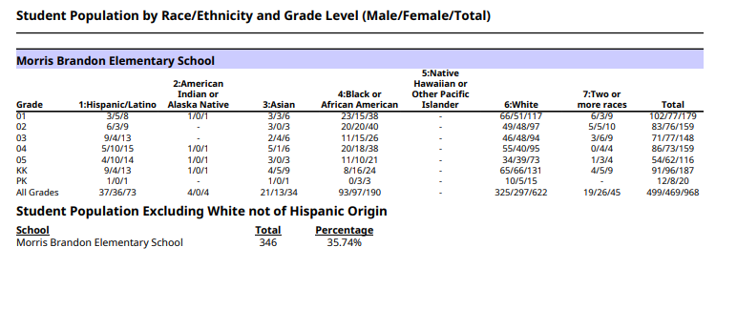
15 Day Enrollment Summary!
Currently 44 students over projection!

Slide 24

DLI Update
In order to further support our Dual Language Immersion (DLI) students, teachers, and classrooms, we added another layer of support this summer!
We are excited to welcome Martha Aguilera, our new Kindergarten Spanish DLI Paraprofessional. In addition, Sra. Park has transitioned to the Primary Center (K–2), while Sra. Sosa has moved to the Main Campus (3–5).
These roles provide targeted Spanish-language support across our DLI classrooms:
Sra. Park (K–2): Building strong foundations in Spanish literacy and speaking skills.
Sra. Sosa (3–5): Expanding students' Spanish speaking and writing skills as they progress into the upper grades.
Martha Aguilera (Kindergarten): Providing additional classroom support to strengthen our youngest DLI students' language development and learning.
This expanded support allows us to be even more intentional about developing bilingualism, biliteracy, and academic success throughout the DLI pathway.

Slide 25
APS PED Policy
Starting last school year (2025–2026), students were asked to keep their phones “up and away” during the school day.
Our Personal Electronic Device policy is a long-standing Board policy designed to support a focused, respectful, and distraction-free learning environment for everyone.
Additionally, this school year (2026–2027), in line with a new state law (HB340), this will expand to include other personal devices like smartwatches, tablets, and headphones.
Click the boxes below for the:
APS Board Policy
APS PED Regulation
Notes:
Principals: Please review the DISTRICT’s Personal Electronic Device Policy. [on the next slide, you will speak to how implementation looks in your school]

Slide 26

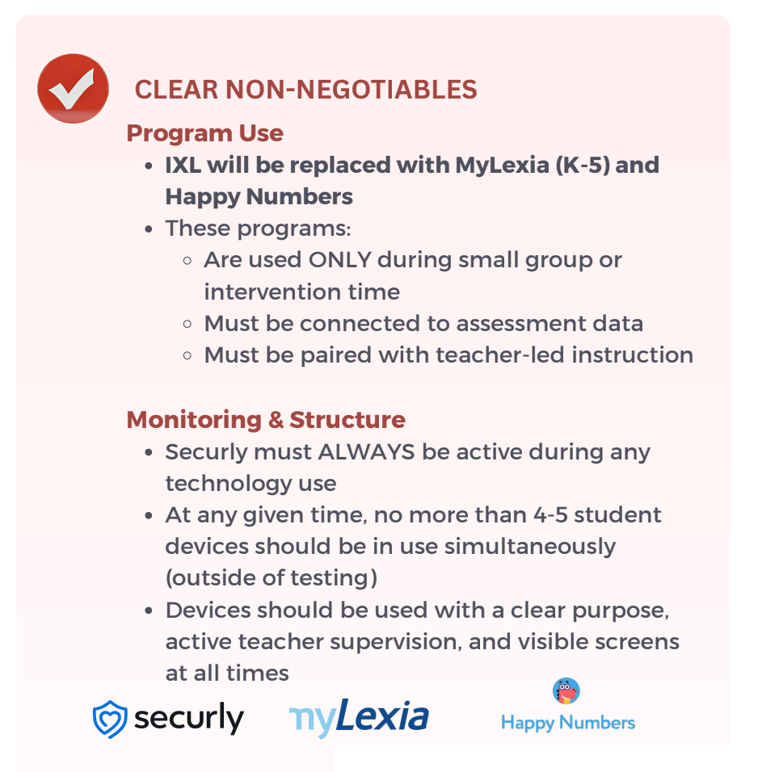
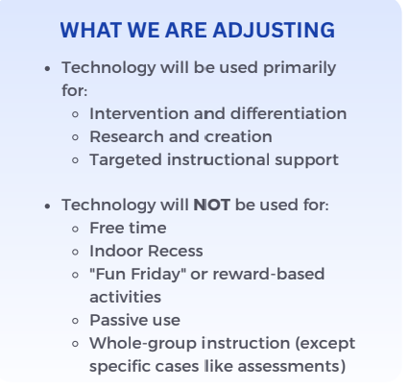
Technology and Morris Brandon
See our grade
level technology
expectations HERE!
Editable text + original visual reference
BACK TO SCHOOL NIGHT
MORRIS BRANDON ELEMENTARY • 2026–2027
Notes:
Briefly discuss technology and the role it plays within your classroom. Be sure to familiarlize yourself with your grade level technology minutes

Slide 27
Announcements
Notes:
Does anyone have any announcements? [Permit GO Team members to provide announcements, as appropriate.]

Slide 28


Complete Training
GO Team Members
Remember to complete your training.
As outlined in Section 2.14 of the GO Team Handbook, GO Team members are required to complete orientation within one year of joining the team and must be renewed every four years.
Failure to complete this training will result in removal from the GO Team
Contact the GO Team Office if you have any questions.
Notes:
The GO Team Office would like to remind all GO Team members that they are required to complete orientation within one year of joining the team and must be renewed it every four years.
Failure to complete the orientation training will result in removal from the GO Team.
Please contact them if you have any questions.

Slide 29
THANK YOU
We’re looking forward to a great year!
Notes:
We have reached the end of our agenda.
Is there any additional business at this time?
[If there is additional business, determine if it should be addressed immediately or placed on the next meeting’s agenda. Once this discussion as concluded, then ask:]
May I have a motion to Adjourn the meeting? A second? All in favor, please say aye or raise your hand. All opposed, please say nay or raise your hand. Any abstentions? Please say abstain or raise your hand.
[The secretary will note the names of the members making motion, seconding the motion and how each member voted.]
Meeting is adjourned.
[The secretary will record the actual time of adjournment in the minutes.

