Slide 1
FY25 Budget Approval Meeting

Slide 2
NORMS
This is a meeting of the GO Team. Only members of the team may participate in the discussion. Any members of the public present are here to quietly observe.
We will follow the agenda as noticed to the public and stay on task.
We invite and welcome contributions of every member and listen to each other.
We will respect all ideas and assume good intentions.

Slide 3
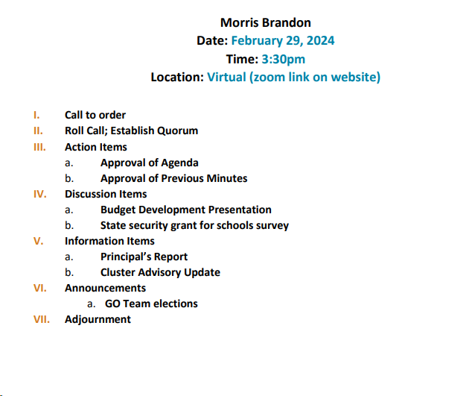
Agenda

Slide 4
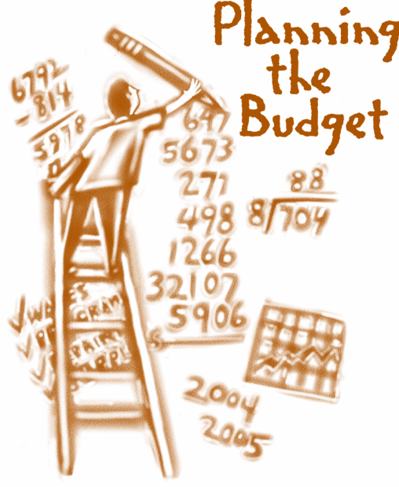
Overview of FY ‘25 GO Team Budget Process
Step 7 GO Team Final Budget Approval Meeting
Budgets Approved by March 15
Step 6 Principals: HR Staffing Conferences Begin
Late February – Early March
Step 5
GO Team Feedback Session: Draft Budget Presented & Discussed
February – multiple meetings, if necessary
Step 4 Principals: Associate Supt. Discussions and Review
February (supports needed, specific challenges, coaching)
Step 3 GO Team Initial Budget Session: Allocation
January 17– early February
Step 2 Principals: Workshop FY 25 Budget
January 17, 2024
Step 1 Review and Update Strategic Plan and Rank Strategic Priorities
By end of Fall Semester
GO Teams are encouraged to have ongoing conversations throughout the year about the school’s budget.

Slide 5
Budget Approval Meeting
What
During this meeting GO Teams will review the budget, which should be updated based on feedback from the staffing conference, Associate Superintendents, and key leaders. After review, GO Teams will need to take action (i.e., vote) on the FY25 Budget.
Why
Principals will present the final budget recommendations for GO Team approval.
When
All approval meetings must be held after staffing conferences. Budgets must be approved by March 15th.

Slide 6
Budget Review

Slide 7
Descriptions of Strategic Plan
Breakout Categories
Priorities: FY25 funding priorities from the school’s strategic plan, ranked by the order of importance.
APS Five Focus Area: What part of the APS Five is the priority aligned to?
Strategies: Lays out specific objectives for school’s improvement.
Request: “The Ask” What needs to be funded in order to support the strategy?
Amount: What is the cost associated with the Request?

Slide 8
FY25 Budget Parameters
FY25 School Priorities | Rationale
Ensure students are reading on grade level and showing growth as it pertains to ELA | CCRPI Data: 85% are reading on or above grade level
Make sure subgroups are making academic progress across all content areas | Students are growing at a different rate. Need to push subgroups to close the gap in proficiency.
Build systems that increase academic and emotional growth for all students. | CIP Goal (BASC-3/BESS): Show a reduction in elevated and highly elevated students in 3 out of 6 grade levels
Increase student mastery in Math, Science and Social Studies | CIP Goal (Proficiency): 71%-76% growth in ELA 69%-75% growth in Math
Increase staff engagement and retention | Retain high quality staff year over year.
Build systems and resources to support the Enhanced IB PYP, DLI and Gifted collaboration implementation | IB Re-authorization is coming up. Self Study in Spring of 2025.
Notes:
Review the priorities that the GO Team has developed and the rationale for these priorities. Feel free to copy this slide if you have more than 3 priorities to account for.

Slide 9
FY25 Budget Parameters
FY25 School Priorities | Rationale
Ensure Special Ed. students are making yearly gains in literacy rates and state targets for ELA | Students are growing at a different rate. Need to push subgroups to close the gap in proficiency.
Build teacher capacity in core content areas, particularly ELA and Reading | Introduction of HB 538, train new staff and teachers (OG/ CRS), and continued training support for new math standards.
Deliver faculty training and maintain or acquire certifications needed to satisfy the professional learning requirements as outlined by HB 538 | Introduction of HB 538, train new staff and teachers in OG/ CRS and state approved modules.
Increase opportunities for student engagement | In order to increase student satisfaction per the student climate survey and school climate rating.
Build culture through staff leadership opportunities | In order to increase staff retention.
Notes:
Review the priorities that the GO Team has developed and the rationale for these priorities.

Slide 10
FY25 Strategic Plan Break-out
Priorities | APS FIVE Focus Area | Strategies | Requests | Amount
Ensure students are reading on grade level and showing growth as it pertains to ELA | Curriculum and Instruction | Fund reading progams (WW/ Fundations/ Heggerty/ MyLexia) | Allot funds to repurchase Wit and Wisdom consumables, leveled texts and reading supports | $20,000
Make sure subgroups are making academic progress across all content areas | Curriculum and Instruction | Hire EIP teachers to support intervention and reduce class size (innovative model) | 8 EIP teachers -2 in 2nd -2 in 4th -1 in 5th - 1.5 for PC (split with ESOL) - .5 for MC (split with ESOl | $764,547
Build systems that increase academic and emotional growth for all students. | Whole Child/ Intervention | Fund wrap around supports | Continue to fund school counselor and SSW | $132,339 (SSW District Funded)
Increase student mastery in Math, Science and Social Studies | Curriculum and Instruction | Fund math program supplements as needed (Envision/ GADOE/ Progress Learning/ Happy Numbers) | Allot funds to repurchase Progress Learning, Happy Numbers, SS Weekly. | $20,000
Notes:
For the next few slides, I will show you how I have allocated the budget to support our strategic priorities.
Based on our strategic priorities and funds we received, here is a break-out of the priorities, which focus area it addresses, the strategies that will be implemented, the purchase request, which funding source was used and the amount.

Slide 11
FY25 Strategic Plan Break-out
Priorities | APS FIVE Focus Area | Strategies | Requests | Amount
Build systems and resources to support the Enhanced IB PYP, DLI and Gifted collaboration implementation | Curriculum and Instruction/ Signature Programing | Retain IB/ Gifted/ DLI staff | Continue to staff IB coordinator, 12 DLI teachers and one full time gifted teacher. | $1,525,994
Ensure Special Ed. students are making yearly gains in literacy rates and state targets for ELA | Whole Child Intervention/ Curriculum and Instruction | Retain .5 Special Ed. Lead Teacher | .5 SELT | $52,020
Build teacher capacity in core content areas, particularly ELA and Reading | Curriculum and Instruction | Implement meaningful professional learning | 7 days of Science of Reading Professional Learning consultant | $7,200
Deliver faculty training and maintain or acquire certifications needed to satisfy the professional learning requirements as outlined by HB 538 | Curriculum and Instruction | Provide meaningful professional learning at the school level | Hire a literacy specialist (district funded), fund internal position vacancy | $109,171
Notes:
For the next few slides, I will show you how I have allocated the budget to support our strategic priorities.
Based on our strategic priorities and funds we received, here is a break-out of the priorities, which focus area it addresses, the strategies that will be implemented, the purchase request, which funding source was used and the amount.

Slide 12
SUMMARY OF POSITION CHANGES TO SUPPORT THE STRATEGIC PLAN
CREATED | REMOVED
EIP 1-3 (FT intervention) | EIP (4-5)- Abolish
EIP Teacher (1-3)- 2nd | EIP (4-5)-3rd
2nd Grade Teacher | Hourly Para (29hrs/ week)
School Clerk (202 days) | Hourly Clerk (29hrs/week)
.5 EIP Teacher-5th grade (CARES)
3rd Grade Teacher (CARES)
Kindergarten Para (CARES)

Slide 13
Staffing Conference Changes
There were not any changes made to the draft budget we discussed at our last meeting.

Slide 14
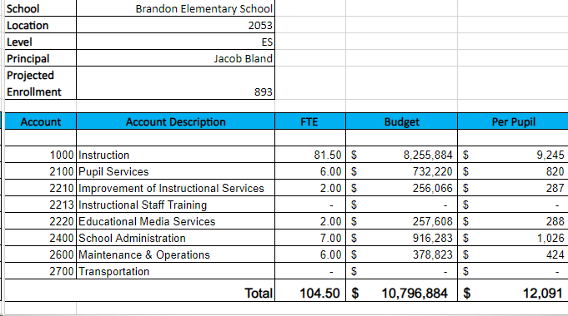
FY25 Budget by Function (Required)
*Based on Current Allocation of School Budget
Notes:
I am passing out the definitions for these funding categories. You will see what makes up each category. Although the school’s total budget amount will not change, allocation per function may change depending on our conversations and school needs.

Slide 15
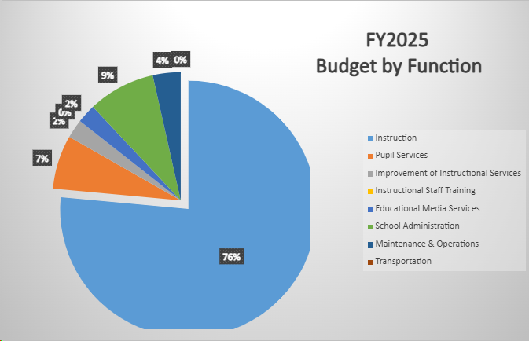
FY25 Budget by Function (Required)
*Based on Current Allocation of School Budget
Notes:
Explain the pie chart and allocations

Slide 16
DISCUSSION OF RESERVE AND HOLDBACK FUNDS

Slide 17
Plan for FY25 Leveling Reserve
$147,086
Priorities | APS FIVE Focus Area | Strategies | Requests | Amount
Build systems that increase academic and emotional growth for all students. | Whole Child/ Intervention | Increase counseling services to align with school recommendation (one counselor for 700 students/ 1.5 recommended for 700-1000 students) | Hire a school counselor | $132,339
Make sure subgroups are making academic progress across all content areas | Curriculum and Instruction | Increase EIP intervention support based on qualifying numbers | Hire an intervention teacher | $132,339
Build systems that increase academic and emotional growth for all students. | Curriculum and Instruction/ Data | Increase opportunities for students to extend their learning | Hire a gifted teacher | $109,221
Deliver faculty training and maintain or acquire certifications needed to satisfy the professional learning requirements as outlined by HB 538 | Curriculum and Instruction | Allot funding to support literacy training initiatives | Literacy consultant to support new literacy coach | $15k
Increase student mastery in Math, Science and Social Studies | Curriculum and instruction/ Data | Allot funding to support a science lab teacher. Put in Specials rotation to relieve counseling. | Hiring option: Hourly Teacher Full time Teacher | ~$30k-110k
Notes:
For the next few slides, I will show you how I have allocated the budget to support our strategic priorities.
Based on our strategic priorities and funds we received, here is a break-out of the priorities, which focus area it addresses, the strategies that will be implemented, the purchase request, which funding source was used and the amount.

Slide 18
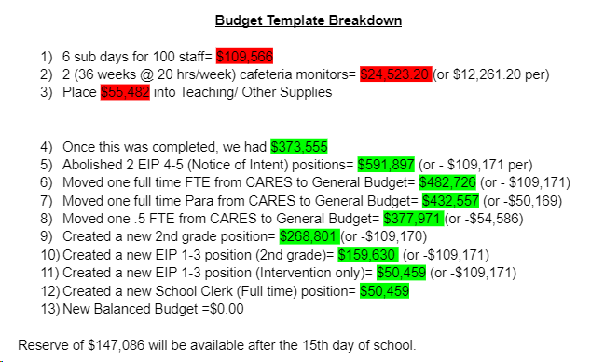
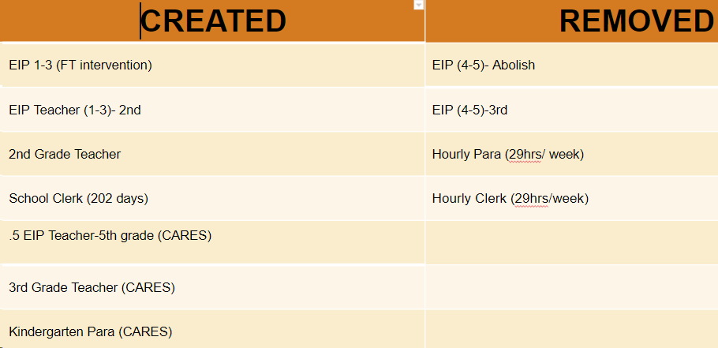
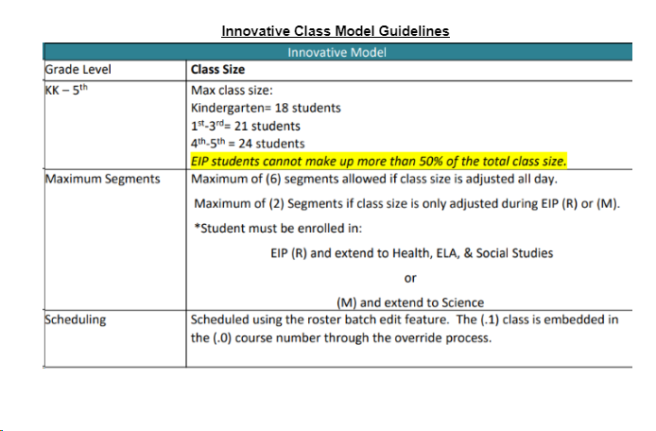
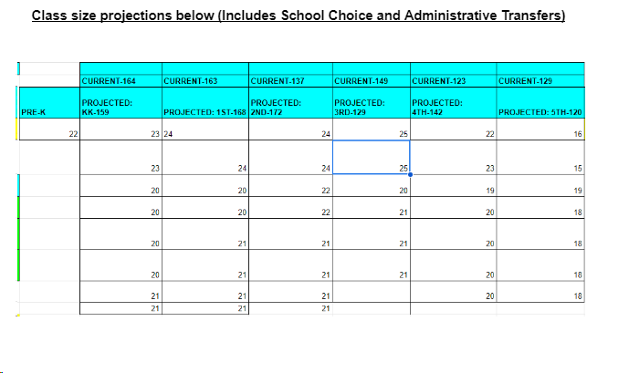

Slide 19
QUESTIONS FOR THE GO TEAM TO CONSIDER AND DISCUSS
Are our school’s priorities (from your strategic plan) reflected in this budget?
Are new positions and/or resources included in the budget to address our major priorities?
Do we know (as a team) the plan to support implementation of these priorities beyond the budget (ex. What strategies will be implemented)?
What tradeoffs are being made in order to support these priorities?
How are district and cluster priorities reflected in our budget?
Cluster priorities- what staff, materials, etc. are dedicated to supporting our cluster’s priorities?
Signature programs- what staff, materials, etc. are dedicated to supporting our signature program?
Are there positions our school will share with another school, e.g. nurse, counselor?
Notes:
CHAIR - Our final task for today! Here are questions that we need to consider to ensure we have a good working draft budget. Let’s walk through them together.

Slide 20
Questions?

Slide 21
The GO Team needs to TAKE ACTION (vote) on the presented budget. After the motion and a second, the GO Team may have additional discussion. Once discussion is concluded, the GO Team will vote.
Action on the Budget

Slide 22
Security Grant Survey

Slide 23
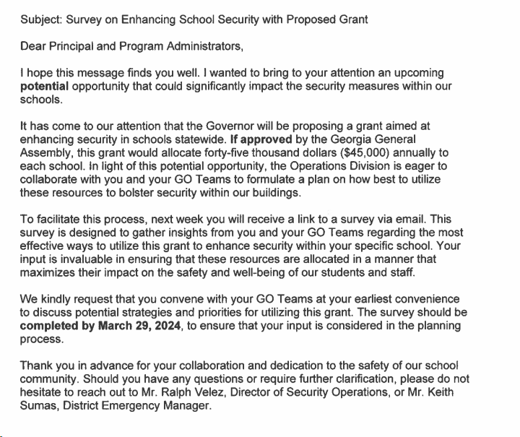
Security Grant
Survey to be released this week (2/26)
Next meeting 3/14/24

Slide 24
Announcements
GO Team members remember to:
Complete your required trainings
Orientation
Ethics
Budget
Complete the end of year surveys (links have been emailed to you)
GO Team Self-Assessment
Principal Feedback

Slide 25
Questions?

Slide 26
Thank you

