Slide 1
MORRIS BRANDON BUDGET FEEDBACK MEETING
To be presented to GO Team BEFORE the school staffing conference

Slide 2
NORMS
This is a meeting of the GO Team. Only members of the team may participate in the discussion. Any members of the public present are here to quietly observe.
We will follow the agenda as noticed to the public and stay on task.
We invite and welcome contributions of every member and listen to each other.
We will respect all ideas and assume good intentions.

Slide 3
GO TEAM BUDGET DEVELOPMENT PROCESS
YOUR SCHOOL STRATEGIC PLAN…
is your roadmap and your role.
It is your direction, your priorities, your vision, your present, your future.
Step 1: Data Review
Step 2: Strategic Plan Review
Step 3: Budget Parameters
(Strategic Priorities)
Step 4: Budget Choices
Notes:
Today I will provide an overview of the budget allocations for FY23. We will begin the work of funding the strategic priorities we agreed upon during our strategic review meeting. (IF YOU HAVE NOT DECIDED ON YOUR PRIORITIES, YOU WILL SAY – WE WILL DECIDE ON OUR PRIORITIES AND THEN DISCUSS ALLOCATING FUNDS TO ADDRESS THOSE PRIORITIES).

Slide 4
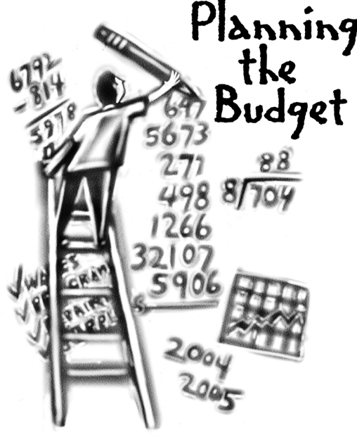
Overview of FY ‘25 GO Team Budget Process
Step 7 GO Team Final Budget Approval Meeting
Budgets Approved by March 15
Step 6 Principals: HR Staffing Conferences Begin
Late February – Early March
Step 5 GO Team Feedback Session
February – ongoing if necessary
Step 4 Principals: Associate Supt. Discussions and Review
February (supports needed, specific challenges, coaching)
Step 3 GO Team Initial Budget Session
January 17 – early February
Step 2 Principals: Workshop FY 25 Budget
January 17
Step 1 Review and Update Strategic Plan
GO Teams are encouraged to have ongoing conversations

Slide 5
Budget Feedback Meeting
What
The GO Team feedback session(s) should be scheduled for the principal to provide an overview of the school’s draft budget for the GO Team members and the general public.
Why
This meeting provides an opportunity for GO Teams to discuss how the school’s budget has been allocated to support the programmatic needs and key strategic priorities.
When
Meetings must be held in February before staffing conferences. May be combined with the allocation meeting (as needed), if the GO Team has completed strategic plan updates and ranked strategic priorities.
Notes:
Looking for general consensus prior to Staffing Conferences

Slide 6
FY25 Budget Parameters
FY25 School Priorities | Rationale
Ensure students are reading on grade level and showing growth as it pertains to ELA | CCRPI Data: 85% are reading on or above grade level
Make sure subgroups are making academic progress across all content areas | Students are growing at a different rate. Need to push subgroups to close the gap in proficiency.
Build systems that increase academic and emotional growth for all students. | CIP Goal (BASC-3/BESS): Show a reduction in elevated and highly elevated students in 3 out of 6 grade levels
Increase student mastery in Math, Science and Social Studies | CIP Goal (Proficiency): 71%-76% growth in ELA 69%-75% growth in Math
Increase staff engagement and retention | Retain high quality staff year over year.
Build systems and resources to support the Enhanced IB PYP, DLI and Gifted collaboration implementation | IB Re-authorization is coming up. Self Study in Spring of 2025.
Notes:
Review the priorities that the GO Team has developed and the rationale for these priorities. Feel free to copy this slide if you have more than 3 priorities to account for.

Slide 7
FY25 Budget Parameters
FY25 School Priorities | Rationale
Ensure Special Ed. students are making yearly gains in literacy rates and state targets for ELA | Students are growing at a different rate. Need to push subgroups to close the gap in proficiency.
Build teacher capacity in core content areas, particularly ELA and Reading | Introduction of HB 538, train new staff and teachers (OG/ CRS), and continued training support for new math standards.
Deliver faculty training and maintain or acquire certifications needed to satisfy the professional learning requirements as outlined by HB 538 | Introduction of HB 538, train new staff and teachers in OG/ CRS and state approved modules.
Increase opportunities for student engagement | In order to increase student satisfaction per the student climate survey and school climate rating.
Build culture through staff leadership opportunities | In order to increase staff retention.
Notes:
Review the priorities that the GO Team has developed and the rationale for these priorities.

Slide 8
Descriptions of Strategic Plan
Breakout Categories
Priorities: FY25 funding priorities from the school’s strategic plan, ranked by the order of importance.
APS Five Focus Area: What part of the APS Five is the priority aligned to?
Strategies: Lays out specific objectives for school’s improvement.
Request: “The Ask” What needs to be funded in order to support the strategy?
Amount: What is the cost associated with the Request?

Slide 9
FY25 Strategic Plan Break-out
Priorities | APS FIVE Focus Area | Strategies | Requests | Amount
Ensure students are reading on grade level and showing growth as it pertains to ELA | Curriculum and Instruction | Fund reading progams (WW/ Fundations/ Heggerty/ MyLexia) | Allot funds to repurchase Wit and Wisdom consumables, leveled texts and reading supports | $20,000
Make sure subgroups are making academic progress across all content areas | Curriculum and Instruction | Hire EIP teachers to support intervention and reduce class size (innovative model) | 8 EIP teachers -2 in 2nd -2 in 4th -1 in 5th - 1.5 for PC (split with ESOL) - .5 for MC (split with ESOl | $764,547
Build systems that increase academic and emotional growth for all students. | Whole Child/ Intervention | Fund wrap around supports | Continue to fund school counselor and SSW | $132,339 (SSW District Funded)
Increase student mastery in Math, Science and Social Studies | Curriculum and Instruction | Fund math program supplements as needed (Envision/ GADOE/ Progress Learning/ Happy Numbers) | Allot funds to repurchase Progress Learning, Happy Numbers, SS Weekly. | $20,000
Notes:
For the next few slides, I will show you how I have allocated the budget to support our strategic priorities.
Based on our strategic priorities and funds we received, here is a break-out of the priorities, which focus area it addresses, the strategies that will be implemented, the purchase request, which funding source was used and the amount.

Slide 10
FY25 Strategic Plan Break-out
Priorities | APS FIVE Focus Area | Strategies | Requests | Amount
Build systems and resources to support the Enhanced IB PYP, DLI and Gifted collaboration implementation | Curriculum and Instruction/ Signature Programing | Retain IB/ Gifted/ DLI staff | Continue to staff IB coordinator, 12 DLI teachers and one full time gifted teacher. | $1,525,994
Ensure Special Ed. students are making yearly gains in literacy rates and state targets for ELA | Whole Child Intervention/ Curriculum and Instruction | Retain .5 Special Ed. Lead Teacher | .5 SELT | $52,020
Build teacher capacity in core content areas, particularly ELA and Reading | Curriculum and Instruction | Implement meaningful professional learning | 7 days of Science of Reading Professional Learning consultant | $7,200
Deliver faculty training and maintain or acquire certifications needed to satisfy the professional learning requirements as outlined by HB 538 | Curriculum and Instruction | Provide meaningful professional learning at the school level | Hire a literacy specialist (district funded), fund internal position vacancy | $109,171
Notes:
For the next few slides, I will show you how I have allocated the budget to support our strategic priorities.
Based on our strategic priorities and funds we received, here is a break-out of the priorities, which focus area it addresses, the strategies that will be implemented, the purchase request, which funding source was used and the amount.

Slide 11
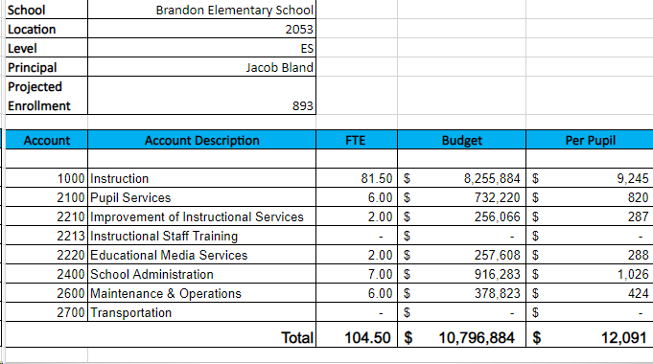
FY25 Budget by Function (Required)
*Based on Current Allocation of School Budget
Notes:
I am passing out the definitions for these funding categories. You will see what makes up each category. Although the school’s total budget amount will not change, allocation per function may change depending on our conversations and school needs.

Slide 12
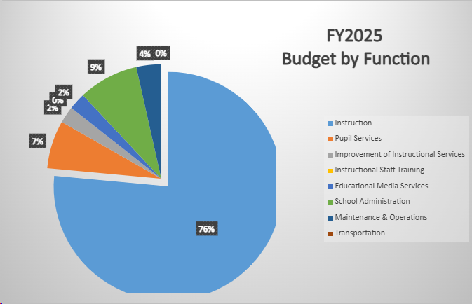
FY25 Budget by Function (Required)
*Based on Current Allocation of School Budget
Notes:
Explain the pie chart and allocations

Slide 13
Class size averages based on new staffing plan:
KK- 169
8 teachers/ 8 paras
Avg. Class Size: 20/ DLI 25
1st-168
8 teacher
Avg. Class Size: 20/ DLI 24
2nd-172
8 teachers
Avg. Class Size: 20/ DLI 24
3rd-129
6 teachers
Avg. Class Size:19/ DLI 25
4th-142
7 teachers
Avg. Class Size: 19/ DLI 22
5th-123
7 teachers
Avg. Class Size: 19/ DLI 15

Slide 14
DISCUSSION OF RESERVE AND HOLDBACK FUNDS

Slide 15
Plan for FY25 Leveling Reserve
$147,086
Priorities | APS FIVE Focus Area | Strategies | Requests | Amount
Build systems that increase academic and emotional growth for all students. | Whole Child/ Intervention | Increase counseling services to align with school recommendation (one counselor for 700 students/ 1.5 recommended for 700-1000 students) | Hire a school counselor | $132,339
Make sure subgroups are making academic progress across all content areas | Curriculum and Instruction | Increase EIP intervention support based on qualifying numbers | Hire an intervention teacher | $132,339
Build systems that increase academic and emotional growth for all students. | Curriculum and Instruction/ Data | Increase opportunities for students to extend their learning | Hire a gifted teacher | $109,221
Deliver faculty training and maintain or acquire certifications needed to satisfy the professional learning requirements as outlined by HB 538 | Curriculum and Instruction | Allot funding to support literacy training initiatives | Literacy consultant to support new literacy coach | $15k
Notes:
For the next few slides, I will show you how I have allocated the budget to support our strategic priorities.
Based on our strategic priorities and funds we received, here is a break-out of the priorities, which focus area it addresses, the strategies that will be implemented, the purchase request, which funding source was used and the amount.

Slide 16
SUMMARY OF POSITION CHANGES TO SUPPORT THE STRATEGIC PLAN
CREATED | REMOVED
EIP 1-3 (FT intervention) | EIP (4-5)- Abolish
EIP Teacher (1-3)- 2nd | EIP (4-5)-3rd
2nd Grade Teacher | Hourly Para (29hrs/ week)
School Clerk (202 days) | Hourly Clerk (29hrs/week)
.5 EIP Teacher-5th grade (CARES)
3rd Grade Teacher (CARES)
Kindergarten Para (CARES)

Slide 17
QUESTIONS FOR THE GO TEAM TO CONSIDER AND DISCUSS
Are our school’s priorities (from your strategic plan) reflected in this budget?
Are new positions and/or resources included in the budget to address our major priorities?
Do we know (as a team) the plan to support implementation of these priorities beyond the budget (ex. What strategies will be implemented)?
What tradeoffs are being made in order to support these priorities?
How are district and cluster priorities reflected in our budget?
Cluster priorities- what staff, materials, etc. are dedicated to supporting our cluster’s priorities?
Signature programs- what staff, materials, etc. are dedicated to supporting our signature program?
Are there positions our school will share with another school, i.e. nurse, counselor?
Notes:
CHAIR - Our final task for today! Here are questions that we need to consider to ensure we have a good working draft budget. Let’s walk through them together.

Slide 18
Where We’re Going?
Our next meeting is the Budget Approval Meeting
What:
During this meeting we will review the budget, which should be updated based on feedback from the staffing conference, Associate Superintendents, and key leaders. After review, GO Teams will need to take action (i.e., vote) on the FY25 Budget.
Why:
Principals will present the final budget recommendations for GO Team approval.
When:
All approval meetings must be held after staffing conferences. Budgets must be approved by March 15th.

Slide 19
Principals Report
February
HR Staffing Conferences (Late February)
March
Final GO Team Approval Meeting (AFTER your school’s Staffing Conference and BEFORE Friday, March 15th)
School Specific:
APS PowerUP registration is open. Please help spread the word (more info in upcoming Beemail/ newsletters)
Readers are Leaders update (HB538)
GOTeam Declarations!
Hiring update
Notes:
In February, we will meet again to discuss how the school’s budget has been allocated to support the programmatic needs and FY23 key strategic priorities.
If think we need to continue our budget conversations, we will schedule additional meetings. My goal is to make sure your voices are reflected in our school’s budget.
I will also be meeting with my Associate Superintendent, program managers and other key leaders to go over our budget and to make sure the school is meeting the standards of service and appropriately staffing.
During the week of Feb. 24th -March 2nd , HR Staffing Conferences will be held. At this meeting, I will present my plan for staff utilization, resource distribution and plan for staffing implications.
We will need to approve the budget at the ________ meeting.

Slide 20
Thank you

