Slide 1

PTO GENERAL MEETING
FRIDAY, JANUARY 23, 2026
Zoom

Slide 2
AGENDA
Welcome and Call to Order
Vote to Approve Minutes from October 2025 PTO General Mtg
PTO Treasurer Report
PTO Events
International Baccalaureate (IB) Continuum Presentation
Principal’s Coffee Talk

Slide 3
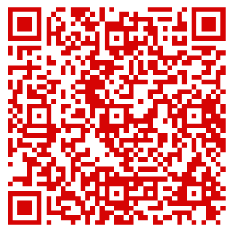
October 2025 PTO General Meeting Minutes
As a reminder, all meeting minutes are posted on our website at
MorrisBrandon.com

Slide 4

October 2025 PTO General Meeting Minutes
Motion to approve the October 2025
PTO General Meeting Minutes

Slide 5
PTO Treasurer Report: Tricia Ricketts
The PTO has had a fantastic school year so far. We have achieved more than 45% of our revenue goal for the year ($84K earned to date with a goal of $183K)
The new PTO entity received approval from the IRS. The process took longer than expected, but we were able to close the PTA bank account in November.
Thanks to your generous support through events like Read-A-Thon and Mom’s Mahjong, as well as the support of our Business Partners, we are able to continue providing fun, FREE events like Boys Night Out, Tall & Small Ball, Field Day, 5th grade celebrations as well as supporting our teachers and staff during our upcoming Teacher Appreciation Week.

Slide 6

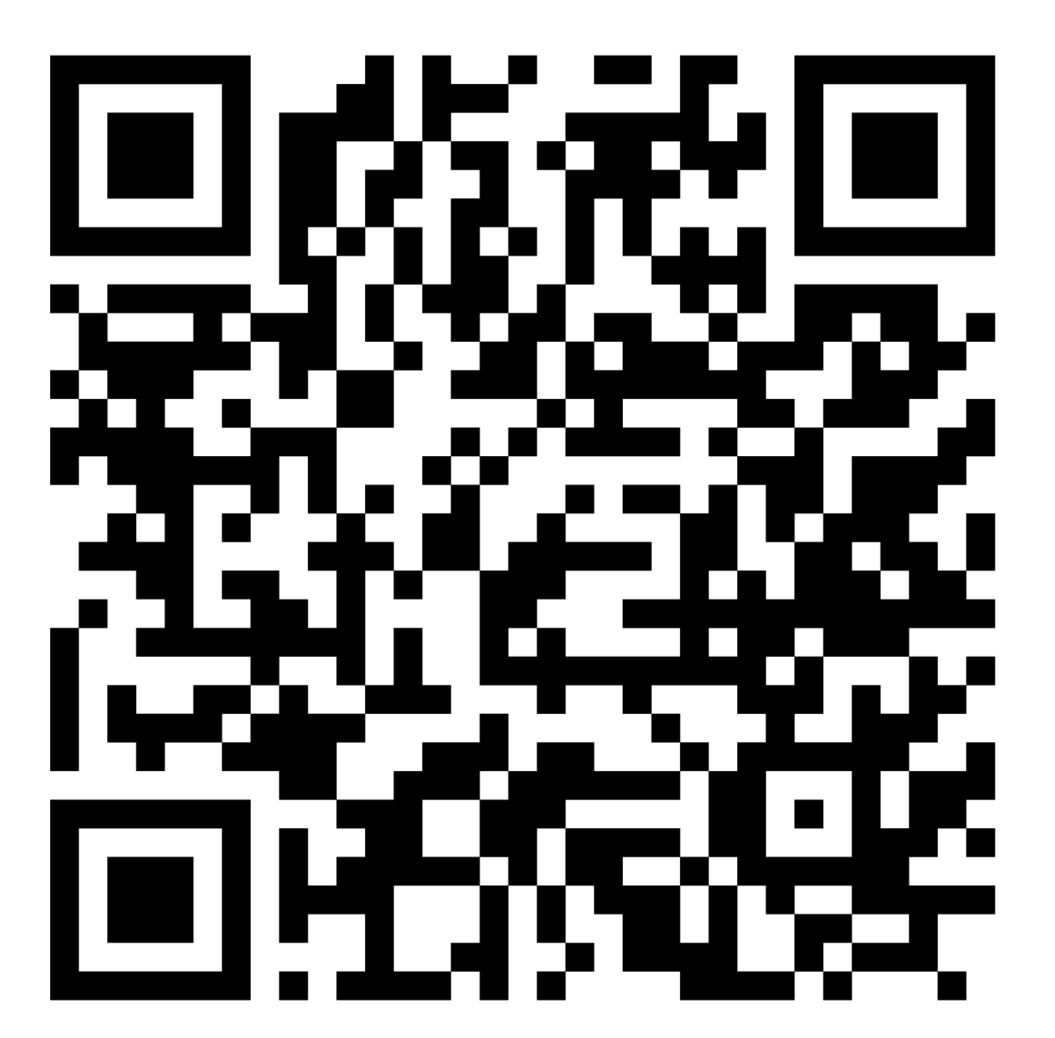
PTO Recent Events
Recent Event Highlights
Willy’s Spirit Night (Oct)
Chick-Fil-A Spirit Night (Nov)
Jamboree (Nov)
Kindergarten & 5th Grade Thanksgiving Feasts (Nov)
Southern Baked Pie Fundraiser (Nov)
Moms Mahjong Fundraiser (Jan)
Read-a-Thon (Starting TODAY through Sunday, February 1!)
Monthly Teacher/Staff Appreciation Meals
Scan for
Read-A-Thon details!

Slide 7

PTO Upcoming Events
Stay up to date! (BEE sure to subscribe to the PTO calendar on the Morris Brandon website.)
Tall & Small Ball (April 24 – it’s a Friday this year!)
World Cultures Night (April 30)
Dad's Golf Tournament (May 1)
Walk to School Day (May 6)
Field Days (May 7, 14, 15)
Rising K Popsicle Social (May 11)
5th Grade Graduation (May 21)
Kindergarten Splashdown (May 22)
Parent/Son Costumes and Clues (Feb 5)
Teacher/Staff Appreciation Week (Feb 9-13)
Bingo Night (Feb 26)
Brandon at the Hawks (March 10)
Chick-Fil-A Spirit Night (March 11)
Brandon's Got Talent (March 19)
Blue Jean Ball –
Parent Party (Friday, March 27)

Slide 8
Reminders
Reminders
Start reading (and donating)! Read-A-Thon starts TODAY, 1/23
Tryout forms are due Friday, 2/6 for Brandon’s Got Talent!
Pre-order your Chick-fil-A for Parent/Son Costumes & Clues Scavenger Hunt by Tuesday, 2/3.
More details are always in the BeeMail every week!
2026-27 PTO Committee Chairs
Check the BeeMail for a link and sign up to chair a PTO committee next year
Next PTO General Meeting
Friday, April 17, 2026

Slide 9
Community Information Presentation How the IB Continuum is intentionally designed to develop skills, habits of mind, and academic readiness progressively from elementary school through high school
Danielle Costarides (IB Coordinator, North Atlanta High School)
Brett Flater (IB Coordinator, Sutton Middle School)

Slide 10
Principal’s Coffee Talk
Jay Bland

