Slide 1

2nd Quarter
Coffee Talk
Morris Brandon

Slide 2
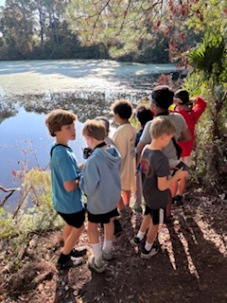
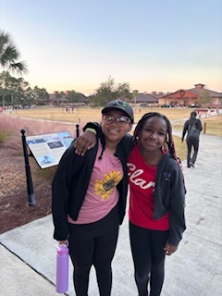
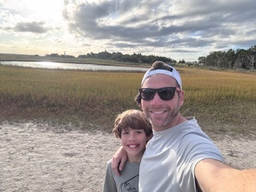
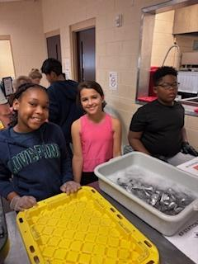

Slide 3
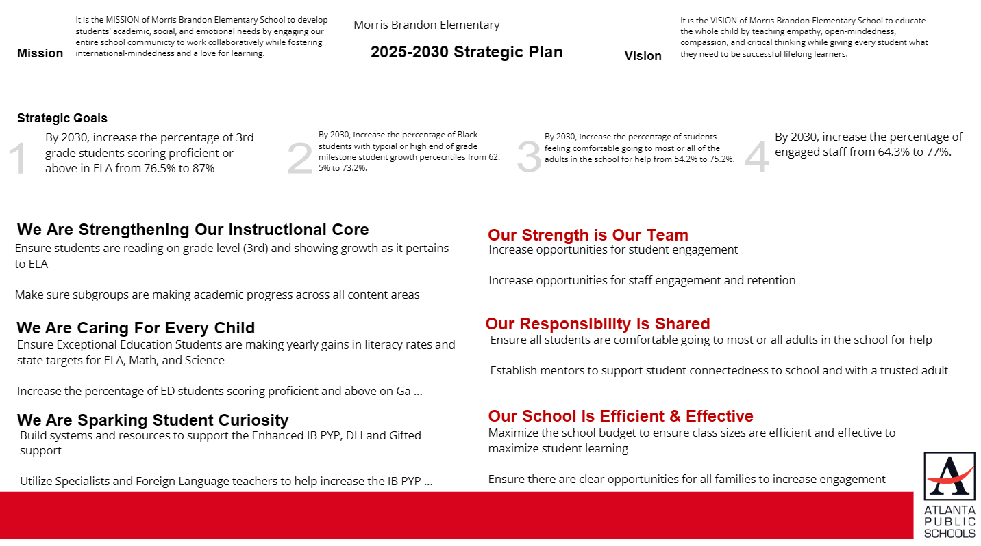
Our Strategic Plan

Slide 4
2026-2027 Strategic Plan Objectives Ranking
Insert the school’s objectives from Higher to Lower
Higher
Ensure students are reading on grade level (3rd) and showing growth as it pertains to ELA
Make sure subgroups are making academic progress across all content areas
Ensure Exceptional Education Students are making yearly gains in literacy rates and state targets for ELA, Math, and Science
Maximize the school budget to ensure class sizes are efficient and effective to maximize student learning
Build systems and resources to support the Enhanced IB PYP, DLI and Gifted support
Increase the percentage of ED students scoring proficient and above on the Ga. Milestones
Increase opportunities for staff engagement and retention
Ensure all students are comfortable going to most or all adults in the school for help
Increase opportunities for student engagement
Establish mentors to support student connectedness to school and with a trusted adult
Utilize Specialists and Foreign Language teachers to help increase the IB PYP overall effectiveness
Create opportunities for all families to increase engagement
Lower

Slide 5
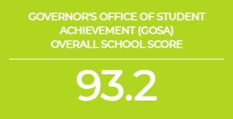
2025 CCRPI Results

Slide 6
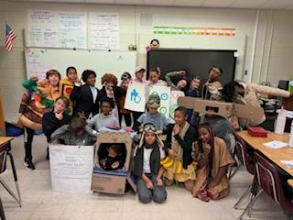
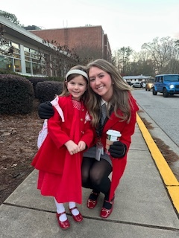
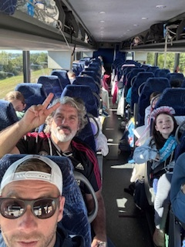
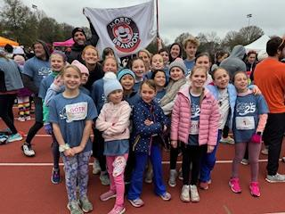
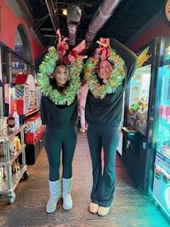

Slide 7
2025-26 Winter MAP Summary at Brandon ES
Data Strategists:
Jennifer Owens – Middle and High in South Atlanta and Carver plus BEST and CSK
Kimberly Lyons – Elementary in Douglass, Mays, Therrell and South Atlanta
Nik Patel – Elementary in North Atlanta, Jackson, Midtown and Washington
Thomas Sugimoto – Middle and High in North Atlanta, Midtown, Jackson
Janay Wilson - Turnaround / Priority Schools
Will Melton – Charter/Partner

Slide 8
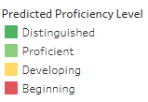

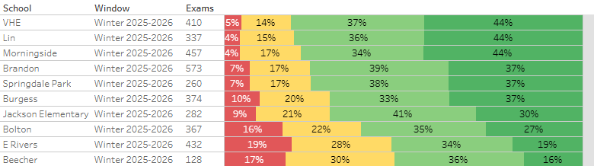
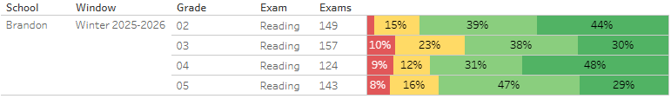
Overall Reading
Brandon ranked 4th in the district in Winter MAP Reading performance for all grades
Individual grades rankings:
#1 in 2nd grade
#7 in 3rd grade
#4 in 4th grade
#6 in 5th grade

Slide 9
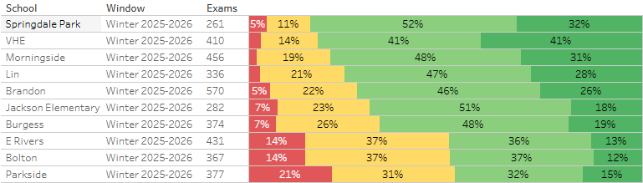
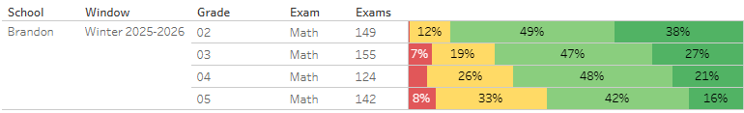
Overall Math
Brandon ranked 5th in the district in Winter MAP Math performance for all grades
Individual grades rankings:
#3 in 2nd grade
#6 in 3rd grade
#4 in 4th grade
#7 in 5th grade

Slide 10
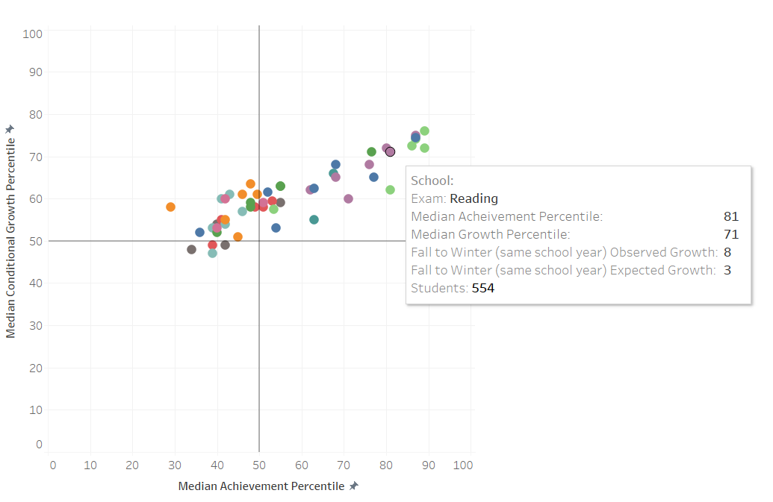
Reading: Achievement vs Growth
Top 10 school in both achievement and growth!
For all K-5, 73% students surpassed growth target, and 5% met, ranking 5th in the district.

Slide 11
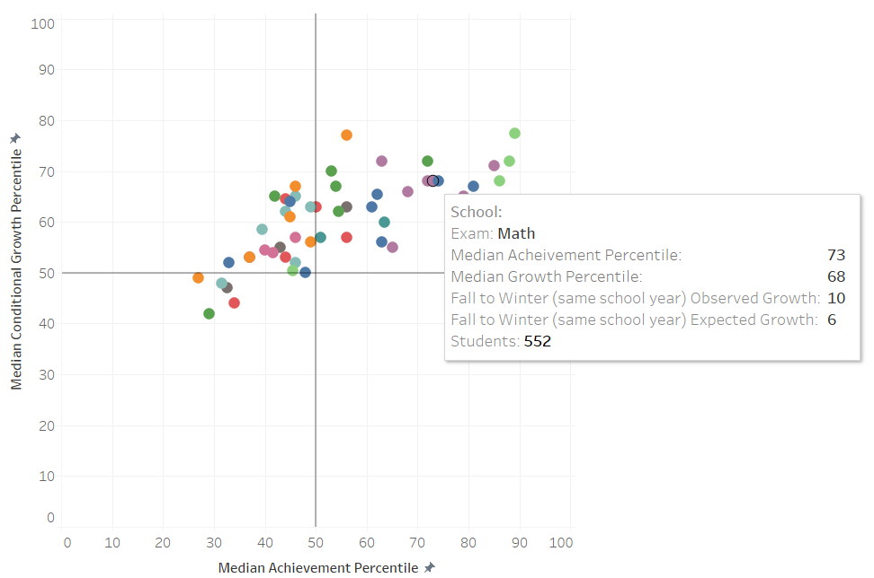
Math: Achievement vs Growth
Top 5 school in achievement!
For all K-5, 68% students surpassed growth target, and 6% met, ranking 6th in the district.

Slide 12
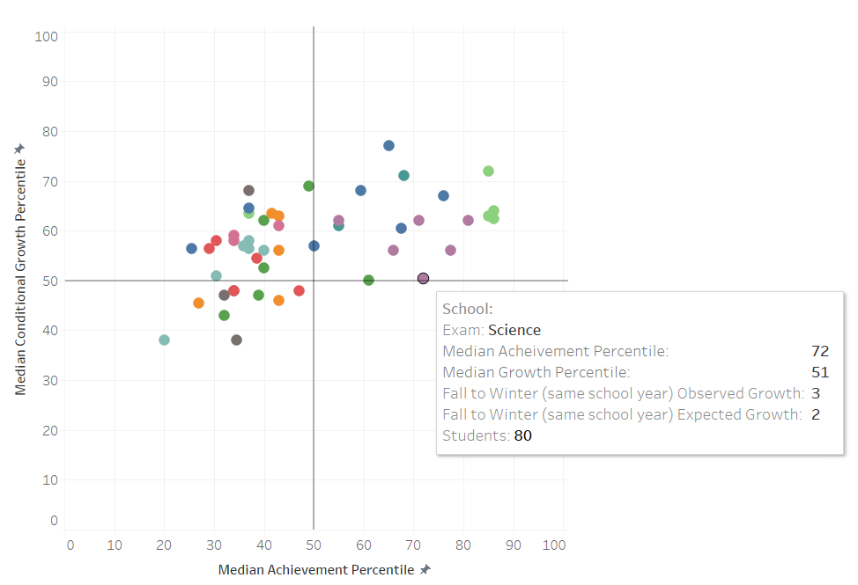
Science: Achievement vs Growth
Top 5 school in achievement!
For all K-5, 53% students surpassed growth target, and 9% met, ranking 19th in the district.

Slide 13
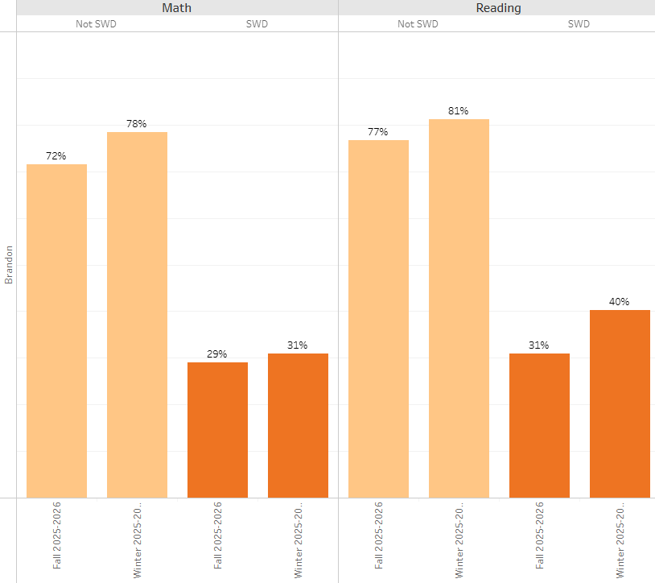
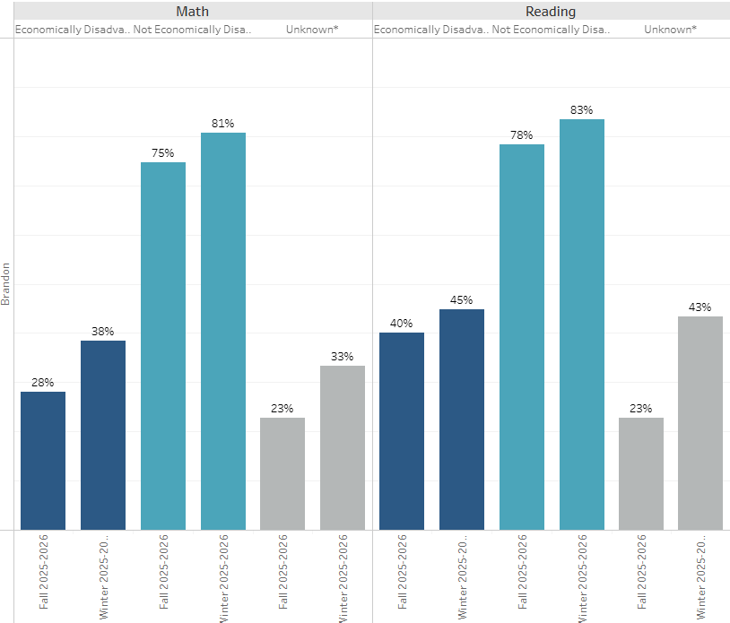
Subgroups: SWD and ED
Saw above average improvement for both SWD and ED students in both math and reading

Slide 14
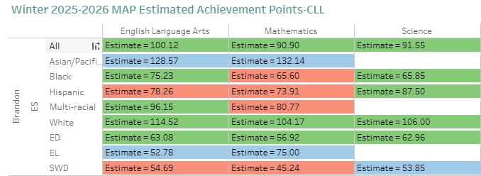
Subgroups: Race/Ethnicity
List of subgroups by distance from target:
SWD, Math: 21.56 points (35 bands)
Hispanic, Math: 16.09 points (23 bands)
Hispanic, Reading: 11.74 points (13 bands)
Multi-racial, Math: 9.23 points
SWD, Reading: 8.12 points (10 bands)
Black, Math: 2.97 points (10 bands)

Slide 15
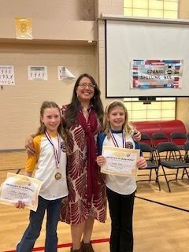
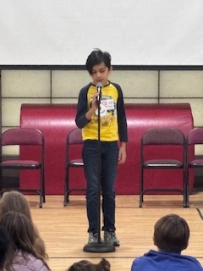
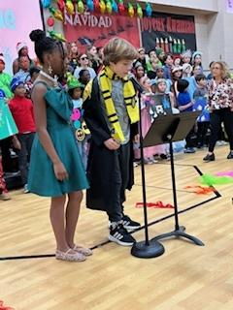

Slide 16
FY27 Budget Development Process:
FY27 Budget Allocation

Slide 17




Executive Summary
This budget represents an investment plan for our school’s students, employees and the community as a whole.
The budget recommendations are tied directly to the school’s strategic vision and direction.
The proposed budget for the general operations of the school are reflected at $$13,944,822
This investment plan for FY27 accommodates a student population that is projected to be 904 students, which is a increase of 16 students from FY26.

Slide 18
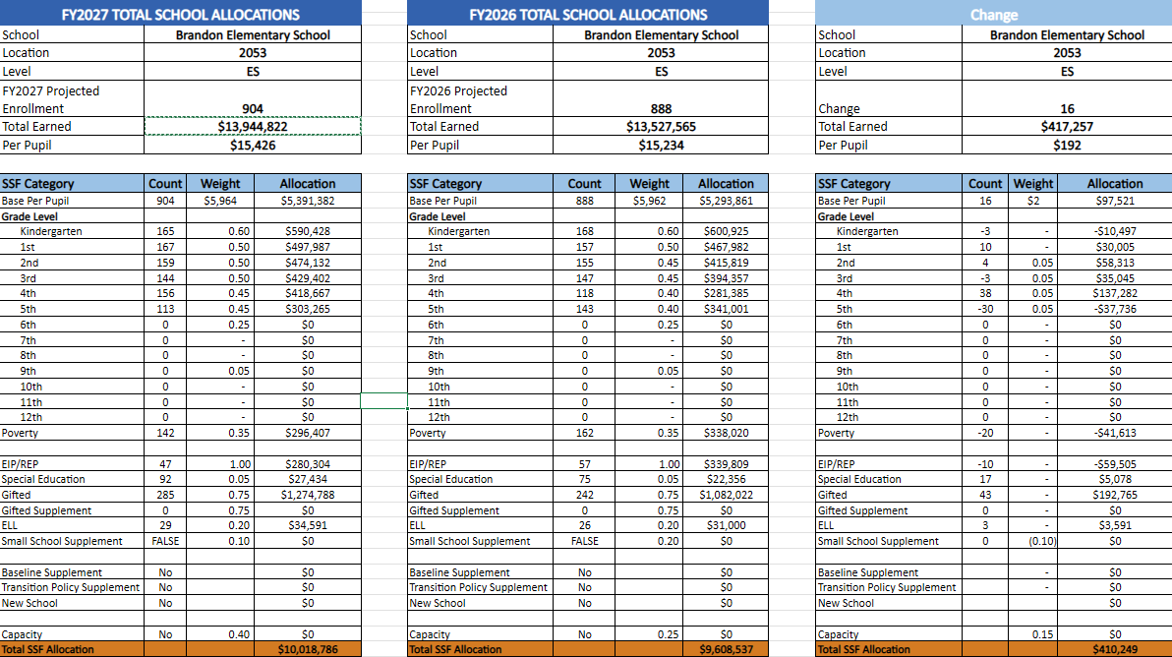
Morris Brandon SSF Allocations

Slide 19
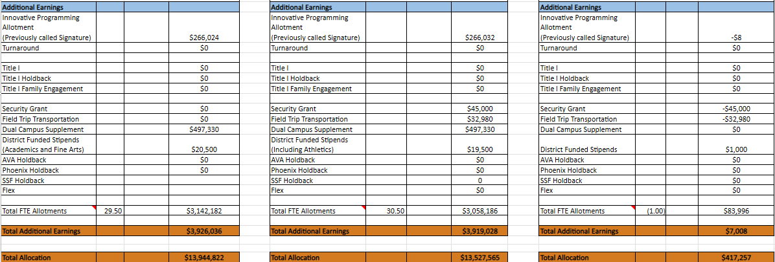
Morris Brandon Additional Earnings

Slide 20
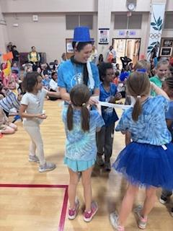
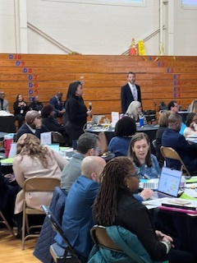
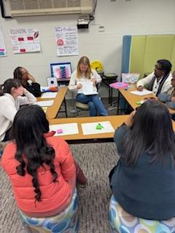
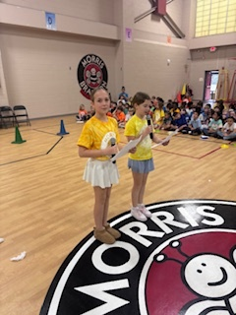
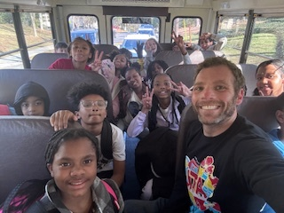
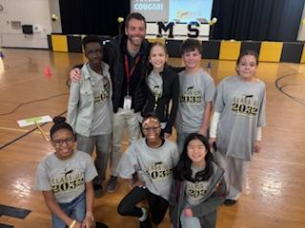

Slide 21

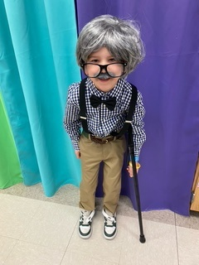



On the Horizon:
Parent/ Son ⅖
TAW- 2/9-2/13
Bingo Night 2/20
Hawks Night 3/10
BGT- 3/19 (Talent show)
Blue Jean Ball- 3/27
Tall and Small Ball 4/24
World Cultures Night 4/30
Dads Golf- 5/1
5th Promotional- 5/21
Splashdown!- 5/22
Jay Bland
@jbland100
@mbprincipal

Slide 22

