Slide 1




GO Team Organizational Meeting
8/21 @ 3:30pm

Slide 2


Call to Order
Roll Call; Establish Quorum
Action Items
Approval of Agenda
Fill Vacant Positions (if applicable)
Fill Open Community Member Seat
Fill Open Swing Seat
For High Schools: Appoint Student Representatives
Approval of Previous Minutes (last meeting of 2024-2025 school year)
Election of Officers and Representatives
    Chair
    Vice-Chair
    Secretary
    Cluster Representative
Review and Approve Public Comment Protocol
Set GO Team Meeting Calendar
Review, Confirm/Update, and Adopt GO Team Meeting Norms
Discussion Items (add items as needed)
Stakeholder Engagement Exercise
Discussion Item 2:
Information Items (add items as needed)
Principal’s Update
    APS Personal Electronic Device Policy (PED)
    Our PED Implementation
APS Forward 2040 –Comprehensive Long Range Facilities Plan
Announcements (add items as needed)
New GO Team Member Training and Orientation
Adjournment
Agenda
Notes:
Call to Order
MEETING LEADER- PRINCIPAL – INTERIM CHAIR
[NOTE: The principal may act as Chair for this meeting ONLY.]
Good Morning/Afternoon/Evening. Welcome to [insert school’s name] GO Team Meeting, where we will follow the agenda as it has been emailed to you and publicly noticed.
I am pleased to call this meeting of the [insert school’s name] GO Team to order at [insert current time]. I will act in the capacity of interim GO Team Chair for this meeting.
Our first order of business is to appoint an interim secretary and call roll. [insert name of appointed interim secretary] will serve as the interim secretary only for this meeting. Our official secretary for the 2025-2026 school year will be elected during this meeting. The interim secretary will now take the roll.

Slide 3


Interim Secretary
Call Roll
Establish Quorum
GO Team will appoint an interim secretary for this meeting.
Interim Secretary will call roll of current GO Team members.
Secretary will announce if the GO Team has a quorum.
The meeting can only proceed if a majority of current members are present.
Notes:
Our first order of business is to appoint an interim secretary and call roll. [insert name of appointed interim secretary] will serve as the interim secretary only for this meeting. Our official secretary for the 2025-2026 school year will be elected during this meeting. The interim secretary will now take the roll.
SECRETARY
Please respond “Present” when your name is called.
[Calls roll of GO Team members and records responses and absences in the minutes.]
PRINCIPAL - INTERIM CHAIR
This team will only be able to take official action if a quorum is present. [insert name of appointed interim secretary], is there a quorum present?
SECRETARY
“YES, there is a quorum present.” OR “No, there is not a quorum present.”
PRINCIPAL - INTERIM CHAIR
If there is NO quorum present: We do not have a quorum present. We needed a majority of GO Team members in attendance to vote on the agenda items. Having a quorum protects the school by preventing a very small number of members from taking action on behalf of the entire school. We will proceed with today’s information items. Discussion and action items will be tabled until a quorum is established. We will need to reschedule this meeting.
If there is a quorum present, proceed to Action Items

Slide 4
Call to Order
Roll Call; Establish Quorum
Action Items
  Approval of Agenda
  Fill Vacant Positions (if applicable)
  Fill Open Community Member Seat
  Fill Open Swing Seat
  For High Schools: Appoint Student Representatives
  Approval of Previous Minutes (last meeting of 2024-2025 school year)
  Election of Officers and Representatives
    Chair
    Vice-Chair
    Secretary
    Cluster Representative
  Review and Approve Public Comment Protocol
  Set GO Team Meeting Calendar
  Review, Confirm/Update, and Adopt GO Team Meeting Norms
Discussion Items (add items as needed)
  Stakeholder Engagement Exercise
  Discussion Item 2:
Information Items (add items as needed)
  Principal’s Update
    APS Personal Electronic Device Policy (PED)
    Our PED Implementation
  APS Forward 2040 –Comprehensive Long Range Facilities Plan
Announcements (add items as needed)
  New GO Team Member Training and Orientation
Adjournment
Approve the Agenda
Notes:
Approval of the Agenda
PRINCIPAL - INTERIM CHAIR
Our first order of business is to Approve the Agenda. This was provided to you and copies are here.
May I have a motion to Approve the Agenda? A second? Are there any amendments to the agenda? [Amendments are made through a motion, second, and voting; if there is general consensus, all offered changes made be made as one motion. If there is not consensus for all changes, then each change should be voted on separately.]
All in favor, please say aye or raise your hand so the secretary can record your vote. All opposed, please say nay or raise your hand. Any abstentions? Please say abstain or raise your hand. [The secretary will note who made the motion, who seconded, and how each member voted.]
We will now move to Filling Vacant Seats, the Open Community Member seat, and the Open Swing Seat. Before we begin the process, I’d like to remind the GO Team of the following:
The Principal brings forth the nominations for the vacant and open community seats,
All GO Team members have only one (1) vote per seat.
Individuals filling a vacant seat will serve until the conclusion of that seat’s term.
Individuals filling an open seat will serve for the full two-year term.
Upon approval, individuals are immediately full GO Team members and may join the meeting.

Slide 5

Vacant Seats are seats which have been vacated prior to the end of the seat’s term.
Individuals appointed to the seat will serve until the end of the seat’s term.
Principal nominates individuals for each vacant seat.
Only if the GO Team has vacant seats
Fill Vacant Seats
The GO Team votes on the nomination for each vacant seat.
Notes:
[Only do this part if the GO Team has one or more vacant seats]
We will begin by filling our Vacant Seats. These are seats which have been vacated prior to the end of the seat’s term. Individuals appointed to the seat will serve until the end of the seat’s term. I have the following nominations for our GO Team’s Vacant Seats and my rationale for their nomination.
[Provide name(s) of individual(s) and which vacant position(s) they are being nominated to fill. The principal may also wish to provide some information as to why the individuals will be an asset to the GO Team and school.]
[repeat the 2 paragraphs below for each vacancy]
I nominate [insert nominee’s name] to fill the vacant position of [insert vacant position]. Does anyone have any comments or discussion about this nominee? [allow GO Team members to comment/discuss. Once discussion concludes, then:]. Thank you for your feedback.
We will now vote on the nomination of [insert nominee’s name] for the position of [insert vacant position]: All in favor, please say aye or raise your hand. All opposed, please say nay or raise your hand. Any abstentions? Please say abstain or raise your hand.

Slide 6
The new Community Member for the open seat will serve for a full two-year term – until June 2027.
Individuals cannot be full-time APS employees.
Principal nominates the individual for the Community Member seat.
Fill Open Community Seat
The GO Team votes on the nomination for the Community Member.
Notes:
We will now move to fill the Open Community Member Seat. This person will serve on the GO Team for a full two-year term.
I nominate [insert nominee’s name] to fill the open Community Member seat. Does anyone have any comments or discussion about this nominee? [allow GO Team members to comment/discuss. Once discussion concludes, then]. Thank you for your feedback.
We will now proceed to vote on the nomination of [insert nominee’s name] for the Community Member seat: All in favor, please say aye or raise your hand. All opposed, please say nay or raise your hand. Any abstentions? Please say abstain or raise your hand. [The secretary will note how each member voted.]

Slide 7
Any GO Team member can nominate someone for the open Swing Seat.
Anyone except school administrators are eligible to fill the seat.
The new Swing Seat member will serve a full two-year term until June 2027.
Fill Open Swing Seat
The GO Team votes on the nomination(s) for the swing seat.
Notes:
We will now move to fill the Open Swing Seat. This person will serve on the GO Team for a full two-year term. Nominations for the Swing Seat member may be made by any GO Team Member. Does anyone have a nomination for the Swing Seat?
[Members provide the name(s) of the individual(s) for the open Swing Seat. The person nominating may also wish to provide some information as to why the individual will be an asset to the GO Team and school. The Secretary will indicate all nominations in the meeting minutes.]
PRINCIPAL - INTERIM CHAIR
Thank you for your nominations. We will now proceed to vote to fill the Swing Seat. Before we begin with voting, does anyone have any additional comments or discussion about any of the nominees? [allow GO Team members to comment/discuss. Once discussion concludes, then] Thank you for your feedback.
[Use this paragraph if ONLY ONE person is nominated]
We will now proceed to vote on the nomination of [insert nominee’s name] for the Swing Seat Member: All in favor, please say aye or raise your hand. All opposed, please say nay or raise your hand. Any abstentions? Please say abstain or raise your hand. [The secretary will note how each member voted.]
[Use this paragraph if MORE THAN ONE person is nominated]
We will now proceed to vote on the nominations for the Swing Seat Member. As I call the nominees’ names, please raise your hand or say aye for the individual you support for the seat.
[The secretary will note how each member voted. Continue with this process until all nominees have been voted on. If no nominee receives a majority of votes (i.e. over 50%), or there is a tie, remove the nominee(s) with the lowest number of votes and proceed to vote again. The secretary will note how each member voted for each round of voting in the minutes].
Congratulations, [insert winner’s name] you will serve in the GO Team’s Swing Seat for the 2025-2027 term!

Slide 8
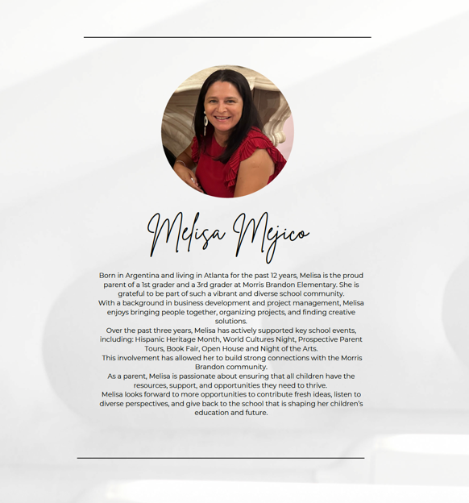

Slide 9
Approval of the previous meeting Minutes
APRIL 17, 2025
Review minutes from the last meeting of the 2024-205 school year.
GO Team will offer amendments and corrections to the minutes.
GO Team will then vote to approve the previous meeting’s minutes.
Notes:
We will review and Approve the Meeting Minutes from our last meeting.
The minutes have been provided to you. Are there any corrections?
If corrections are offered, the Chair permits discussion by the members, to ensure everyone agrees that the correction is accurate. The secretary then enters the corrections on the master copy. When no further corrections are offered, the Chair says,
If there are no (further) corrections, may I have a motion to approve the previous meeting’s minutes? A second? All in favor, please say aye or raise your hand. All opposed, please say nay or raise your hand. Any abstentions? Please say abstain or raise your hand.
[The secretary will note who made the motion, who seconded, and how each member voted.]

Slide 10




Election of Officers
Find more information about officer positions in the GO Team Handbook
CHAIR
  Works with GO Team to create the agenda
  Leads meetings
  Monitors GO Team compliance with Open Meeting Laws and member training
VICE-CHAIR
  Ensures compliance with parliamentary procedure
  Acts as Chair, if the Chair is absent
SECRETARY
  Takes minutes at meetings
  Ensures compliance with Open Meeting Laws by posting GO Team documents on the school’s GO Team webpage
CLUSTER REP
  Attends Cluster Advisory Team (CAT) meetings (about 3/year)
  Reports out at CAT about your school
  Brings cluster report back to GO Team
  Can hold an officer position
The GO Team Office provides additional training and resources for officers.
Notes:
We will now move to electing GO Team officers and representatives. Before we begin the nominations, I’d like to remind the GO Team of the following-
Nominations do not have to be seconded.
A member may nominate themselves.
A member may nominate more than one person for any position.
A member may decline a nomination during the nomination process.
(High schools) Students may fill any officer position.
Members may not serve more than two (2) consecutive terms (i.e.- 2 years) in the same officer position at the same school.
Nominees do not have to leave the room during the nomination period or when a vote is taken.
If there is more than one nominee per elected office, each nominee will be offered an opportunity to share why they should be elected to the seat.
The newly elected officers will assume their position starting at the conclusion of this meeting and serve until June 30.
All voting members have only one vote per seat.

Slide 11
Chair Responsibilities
The GO Team Chair is the leader of the GO Team and presides at all meetings of the GO Team.
Key Responsibilities
Leading GO Team Meetings
Working with the Principal and GO Team to develop meeting Agendas
Ensuring every GO Team member has an opportunity to be heard
Monitoring team compliance
Qualifications
A commitment to the school and its values and an understanding of the school’s objectives, organization, and services
Knowledge of, and ability to work with, the broader school community
Ability to understand concepts and articulate ideas
Willingness to learn facilitation skills and provide balanced leadership
CHAIR
Notes:
First, we will elect the GO Team’s Chair. As a reminder, the responsibilities of the Chair include, but are not limited to
Leading GO Team Meetings
Working with the Principal and GO Team to develop meeting Agendas
Ensuring every GO Team member has an opportunity to be heard
Monitoring team compliance
I will now open the floor to receive Chair nominations. [Secretary will record all nominations.]
Would any of the nominees like to decline the nomination? [Note to Secretary: If someone declines the nomination, have the secretary write “Nomination Declined” by the nominee’s name on the minutes sheet.]
If there are no further nominations, I will close the floor. We will begin the confirmation process. We have [insert number] people being considered for the Chair seat.
The nomination(s) for Chair is/are [insert candidate(s)’ name(s)].
At this time I will offer each Chair nominee an opportunity to explain why they are the best candidate for the position. Other GO Team members may ask the nominees questions before voting.
[Allow reasonable amount of time for the nominees to speak and the other GO Team members to ask questions.]
Please raise your hand to vote for your choice for Chair of our GO Team [Chair will announce each candidate’s name and allow GO Team members to vote.] Any abstentions? Please say abstain or raise your hand. [The secretary will note how each member voted.]
[Note to Chair: If there is a majority winner, proceed to the below announcement. If there is no majority winner, narrow the field to the top 2 candidates and vote again. If there is a tie between 2 candidates, have additional discussion and vote again.]
Congratulations, [insert winner’s name] you will serve as the GO Team Chair for this school year!

Slide 12
Vice-Chair Responsibilities
The GO Team Vice-Chair assists the GO Team Chair in providing leadership to the GO Team and presides at all meetings of the GO Team in the absence of the Chair.
Key Responsibilities
Ensuring the GO Team follows parliamentary procedure
Working with the Principal and Chair to develop meeting Agendas
Acting as Chair, if the Chair is not present.
Qualifications
A commitment to the school and its values and an understanding of the school’s objectives, organization, and services
Knowledge of, and ability to work with, the broader school community
Ability to understand concepts and articulate ideas
Willingness to learn facilitation skills and provide balanced leadership
VICE-CHAIR
Notes:
Now, we will elect the GO Team’s Vice-Chair. As a reminder, the responsibilities of the Vice-Chair include, but are not limited to
Ensuring the GO Team follows parliamentary procedure
Working with the Principal and Chair to develop meeting Agendas
Acting as Chair, if the Chair is not present.
I will now open the floor to receive Vice-Chair nominations. [Secretary will record all nominations.]
Would any of the nominees like to decline the nomination? [Note to Secretary: If someone declines the nomination, have the secretary write “Nomination Declined” by the nominee’s name on the minutes sheet.]
If there are no further nominations, I will close the floor. We will begin the confirmation process. We have [insert number] people being considered for the Vice-Chair seat.
The nomination(s) for Vice-Chair is/are [insert candidate(s)’ name(s)].
At this time I will offer each Vice-Chair nominee an opportunity to explain why they are the best candidate for the position. Other GO Team members may ask the nominees questions before voting. [Allow reasonable amount of time for the nominees to speak and the other GO Team members to ask questions.]
Please raise your hand to vote for your choice for Vice-Chair of our GO Team [Chair will announce each candidate’s name and allow GO Team members to vote.] Any abstentions? Please say abstain or raise your hand. [The secretary will note how each member voted.]
[[Note to Chair: If there is a majority winner, proceed to the below announcement. If there is no majority winner, narrow the field to the top 2 candidates and vote again. If there is a tie between 2 candidates, have additional discussion and vote again.]
Congratulations, [insert winner’s name] you will serve as the GO Team Vice-Chair for this school year!

Slide 13
Secretary Responsibilities
The GO Team Secretary is responsible for communication regarding GO Team meetings and documenting the work and decisions of the GO Team.
Key Responsibilities
Posting GO Team documents (agendas, summaries, and minutes) to the website
Taking minutes at GO Team meetings
Ensuring the GO Team is in compliance with Georgia Open Meeting Laws
Qualifications
A commitment to the school and its values and an understanding of the school’s objectives, organization, and services.
Knowledge of, and ability to work with, the broader school community
Willingness to learn about and ensure GO Team compliance with Robert’s Rules of Order and Georgia’s Open Meetings and Records laws
Organization skills and an ability to adhere to deadlines
SECRETARY
Notes:
Now, we will elect the GO Team’s Secretary. As a reminder, the responsibilities of the Secretary include, but are not limited to
Posting GO Team documents (agendas, summaries, and minutes) to the website
Taking minutes at GO Team meetings
Ensuring the GO Team is in compliance with Georgia Open Meeting Laws
I will now open the floor to receive Secretary nominations. [Secretary will record all nominations.]
Would any of the nominees like to decline the nomination? [Note to Secretary: If someone declines the nomination, have the secretary write “Nomination Declined” by the nominee’s name on the minutes sheet.]
If there are no further nominations, I will close the floor. We will begin the confirmation process. We have [insert number] people being considered for the Secretary seat.
The nomination(s) for Secretary is/are [insert candidate(s)’ name(s)].
At this time I will offer each Secretary nominee an opportunity to explain why they are the best candidate for the position. Other GO Team members may ask the nominees questions before voting. [Allow reasonable amount of time for the nominees to speak and the other GO Team members to ask questions.]
Please raise your hand to vote for your choice for Secretary of our GO Team [Chair will announce each candidate’s name and allow GO Team members to vote.] Any abstentions? Please say abstain or raise your hand. [The secretary will note how each member voted.]
[[Note to Chair: If there is a majority winner, proceed to the below announcement. If there is no majority winner, narrow the field to the top 2 candidates and vote again. If there is a tie between 2 candidates, have additional discussion and vote again.]
Congratulations, [insert winner’s name] you will serve as the GO Team Secretary for this school year!

Slide 14
Cluster Advisory Team Representative Responsibilities
The CAT Representative serves as the voice of their school’s GO Team within the Cluster Advisory Team. The CAT Rep may also be the Chair, Vice-Chair, or Secretary.
Key Responsibilities
Attend all Cluster Advisory Team Meetings
Represent your school at the CAT Meetings
Bring relevant information and reports back to your GO Team
Qualifications
Willingness to collaborate with schools, principals, and community partners
Interest in supporting continuous improvement and equity across schools
Knowledge of, and ability to work with, the broader cluster community
CLUSTER REP
Notes:
Now, we will elect the GO Team’s Cluster Representative. Cluster Representatives may also hold an officer position (Chair, Vice-Chair, or Secretary). As a reminder, the responsibilities of the Cluster Representative include, but are not limited to
Attending all Cluster Advisory Team (CAT) meetings (approximately 3)
Reporting back to the GO Team on the CAT meetings
I will now open the floor to receive Cluster Representative nominations. [Secretary will record all nominations.]
Would any of the nominees like to decline the nomination? [Note to Secretary: If someone declines the nomination, have the secretary write “Nomination Declined” by the nominee’s name on the minutes sheet.]
If there are no further nominations, I will close the floor. We will begin the confirmation process. We have [insert number] people being considered for the Cluster Representative seat.
The nomination(s) for Cluster Representative is/are [insert candidate(s)’ name(s)].
At this time I will offer each Cluster Representative nominee an opportunity to explain why they are the best candidate for the position. Other GO Team members may ask the nominees questions before voting. [Allow reasonable amount of time for the nominees to speak and the other GO Team members to ask questions.]
Please raise your hand to vote for your choice for Cluster Representative of our GO Team [Chair will announce each candidate’s name and allow GO Team members to vote.] Any abstentions? Please say abstain or raise your hand. [The secretary will note how each member voted.]
[Note to Chair: If there is a majority winner, proceed to the below announcement. If there is no majority winner, narrow the field to the top 2 candidates and vote again. If there is a tie between 2 candidates, have additional discussion and vote again.]
Congratulations, [insert winner’s name] you will serve as the GO Team Cluster Representative for this school year!

Slide 15
Requirements
Opportunities for public comment shall be provided at least four (4) times in a school/fiscal year and noted on the GO Team’s webpage and meeting agenda;
GO Team members will not provide responses or engage in direct conversation during public comment;
Each GO Team will determine a consistent method for receiving public comments and for parents and other citizens to sign up to address the team;
At least 20 minutes of time will be allotted for the public to make comments at meetings where public comment is permitted; and
The public will receive at least 2 business days’ notice of the Public Comment Protocol.
Public Comment Protocol
Notes:
We will now move to our next item of business in reviewing and updating or confirming our GO Team’s Public Comment Protocol. Public comment opportunities are available for GO Teams to hear from interested members of the community.
From Section 3.4 of the GO Team Handbook:
Opportunities for public comment shall be provided at least four (4) times in a school/fiscal year and noted on the GO Team’s webpage and meeting agenda;
GO Team members will not provide responses or engage in direct conversation during public comment;
Each GO Team will determine a consistent method for receiving public comments and for parents and other citizens to sign up to address the team;
At least 20 minutes of time will be allotted for the public to make comments at meetings where public comment is permitted; and
The public will receive at least 2 business days’ notice of the Public Comment Protocol.

Slide 16
Public Comment Is Not Mandatory at Every Meeting: GO Teams are not required to include a Public Comment period at every meeting, but should be scheduled for meetings involving major action items needing community input.
Plan and Structure Public Comment Thoughtfully: When included, Public Comment should be scheduled at a specific time (e.g., a 20-minute segment with 2 minutes per speaker) and aligned with the school community’s availability to encourage participation.
Establish a Clear and Transparent Process: Provide clear instructions for how individuals can sign up to speak. During the Public Comment period, GO Team members should listen without responding, using the input to inform decisions.
Encourage Ongoing Community Engagement: Remind stakeholders that Public Comment during meetings is just one way to share input. Emails to GO Team members and special sessions can also serve as valuable channels for community feedback.
Public Comment Protocol Tips
Public Comment Signup (Example)
The GO Team votes on its
Public Comment Protocol
Notes:
Please take a moment to review our current public comment protocol and information. Are there any recommendations for updates or changes to our Public Comment Protocol? [NOTE: Your GO Team may vote to leave the Public Comment Protocol unchanged.]
Some tips for Public Comment Protocol (from the GO Team Handbook):
The GO Team is not required to schedule time for Public Comment at every meeting.
Public Comment should be scheduled for major action items (items that need a GO Team vote) that will require public input or need public buy-in.
Consider the schedule of the school community for those meetings that do allow Public Comment in order to give your community the chance to participate.
Set a specific time for your Public Comment period. For example, you could allot a 20-minute segment on the agenda for Public Comment and allow each member of the public to have 2 minutes to speak during that segment.
Post a clear process for how individuals sign-up or indicate they wish to speak.
GO Team members should not respond during the Public Comment period. The Public Comment period is designed to gain input from the public – not for immediate responses by the GO Team to the public comment presented. The GO Team should listen attentively to all comments and take the summation of the comments into consideration when making decisions.
Remind the public that a scheduled Public Comment period on the agenda is not the only means for providing input. If there are urgent matters that need the GO Team’s attention, the school can organize Information Sessions or the GO Team can schedule separate Public Comment meetings to gather that information from stakeholders.
GO Team discusses and potentially updates the team’s public comment protocol.
May I have a motion to adopt this Public Comment Protocol? A second? All in favor, please say aye or raise your hand. All opposed, please say nay or raise your hand. Any abstentions? Please say abstain or raise your hand.
[The secretary will note who made the motion, who seconded, and how each member voted in the minutes. The secretary will also record the approved Public Comment format in the minutes.]

Slide 17
ProposedMeeting
Calendar
Requirements
Hold at least six (6) business meetings this school year (this meeting plus at least 6 more);
At least four (4) of the meetings must permit time for Public Comment;
Meetings cannot be held during the instructional school day;
Meetings must be live-streamed and recorded; and
Meeting locations for hybrid meetings must be places which can accommodate the public (i.e. – not a conference room).
 | Date | Time | Virtual or Hybrid | Time for Public Comment? (Yes/No)
1 | Sept 18 | 3:30PM | Virtual | Yes
2 | Oct 23 | 3:30PM | Virtual | No
3 | Nov 13 | 3:30PM | Virtual | Yes
4 | Dec 11 | 3:30PM | Virtual | No
5 | Jan 22 | 3:30PM | Virtual | Yes
6 | Feb 12 | 3:30PM | Virtual | No
7 | Feb 26 | 3:30PM | Virtual | Yes
8 | March 12 | 3:30PM | Virtual | No
9 | April 16 | 3:30PM | Virtual | No
Notes:
Adhering to the agenda, we will now discuss our Meeting Calendar for this school year. As a reminder our GO Team is required to:
have at least six (6) business meetings this school year – this meeting plus at least 6 more);
four (4) of the meetings must permit time for Public Comment;
meetings cannot be held during the instructional school day;
meetings must be live-streamed and recorded; and
meeting locations for hybrid meetings must be places which can accommodate the public (i.e. – not a conference room).

Slide 18
Hold at least 3 business meetings per semester: This will ensure your GO Team has sufficient time to complete its business
Fall Semester 2025: Your GO Team will be developing its 2025-2030 Strategic Plan to align with the District’s new strategic plan; allow enough time to complete this work
Budget Meetings:
  Allocation Meeting: Late January
  Draft Feedback Meeting: Early February – before February break
  Finalization Meeting: Early March – after staffing conferences
Public Comment: Select at least four (4) of meetings that will allow time for public comment.
Meeting Calendar Considerations
The GO Team votes on its
Meeting Calendar
Notes:
May I have suggestions/recommendations for meeting dates and times? [Your GO Team MUST schedule at least 6 business meetings at this time; please refer to Meetings-At-A-Glance for a suggested schedule.]
[Note to Chair: Your GO Team should plan on 3 meetings for the budget process:
The first in late January to early February to review budget allocation;
The second in early to mid February for draft budget presentation and feedback; and
The third in early March for budget approval]
[After your GO Team has determined meeting dates and times:]
We now need to determine at which meeting we will allocate time for Public Comment. As a reminder, we must allow for Public Comment at least 4 times during the school year.
Now that we have determined our calendar, may I have a motion to approve the calendar? A second? All in favor, please raise your hand. All opposed, please raise your hand. Any abstentions? Please raise your hand.
[The secretary will note who made the motion, who seconded, and how each member voted and record the meeting dates in the minutes.]
Please enter these dates into your personal calendars so you do not forget!

Slide 19
Initial Norms
This is a meeting of the GO Team. Only members of the team may participate in the discussion. Any members of the public present are here to quietly observe.
We will be fully present.
We will follow the agenda as noticed to the public and stay on task.
We will be respectful of each other at all times.
We will be open-minded.
We invite and welcome contributions of every member and listen to each other.
We will respect all ideas and assume good intentions.
We will approach differences of opinion with curiosity.
Meeting
Norms
The GO Team may change these norms.
The GO Team votes on its meeting norms.
Notes:
Now we will determine our GO Team Meeting Norms. We’ll begin by reviewing the initial GO Team Meeting Norms.
Does anyone have any changes to these norms? [NOTE: Your GO Team may vote to leave the Norms unchanged.]
[Once discussion has completed:]
May I have a motion to adopt these Norms for our GO Team? A second? All in favor, please say aye or raise your hand. All opposed, please say nay or raise your hand. Any abstentions? Please say abstain or raise your hand.
[The secretary will note who made the motion, who seconded, and how each member voted and record the Meeting Norms in the minutes.]

Slide 20
Discussion Items
Notes:
We will now move to the Discussion Items on our agenda.

Slide 21
Why We’re Here
GO Teams play a vital role in decision-making that impacts the school’s direction, priorities, and overall success.
Stakeholder engagement ensures that the decisions we make reflect the real needs and voices of the people our schools serve.
We’re stronger when we bring others into the work—when we listen, learn, and co-create with families, students, staff, and community members.
Today our GO Team will: Brainstorm ways to involve our school’s key stakeholders in our work.
Stakeholder
Engagement
Exercise
Notes:
Next, we’re going to discuss stakeholder engagement. As a charter system, the decisions the GO Team makes shapes our school’s future — and the best decisions come from hearing the diverse voices within our school community..
When we bring families, students, staff, and our community into the work—not just into the audience—we get stronger ideas, better outcomes, and a shared vision we can all stand behind.

Slide 22
Here’s the challenge:
We’re going to look at four groups—Families, Students, Staff, and Community.
For each group, we’ll ask and answer three questions:
INFORM – What’s a fun or unexpected way to keep them in the loop?
INPUT – What’s a meaningful way to get their ideas or feedback?
INVITE – How can we bring them into the work, not just the audience?
Let’s get creative, specific, and push past the usual answers.
Stakeholder
Engagement
Exercise
Notes:
Here’s the challenge: We’re going to look at four groups—Families, Students, Staff, and Community.
For each one, we’ll answer three questions:
INFORM – What’s a fun or unexpected way to keep them in the loop?
INPUT – What’s a meaningful way to get their ideas or feedback?
INVITE – How can we bring them into the work, not just the audience?
Let’s get creative, get specific, and push past the usual answers.

Slide 23
 | FAMILIES | STUDENTS | STAFF | COMMUNITY
INFORM What’s a fun, unexpected way to keep them in the loop? | GO into communities to share information; Deliver messages through their children; Create one pagers w QR codes and send them home on the bus.
INPUT What’s a meaningful way to gather their ideas or feedback? | Famiy Engagement survey; Social Media share out; Personal outreach assigned by GOteam.
INVITE How can we bring them into the work, not just the audience? | Nominations for GOTeam!; PTO; Foundation; Room Parents
Notes:
Here’s the challenge: We’re going to look at four groups—Families, Students, Staff, and Community.
For each one, we’ll answer three questions:
INFORM – What’s a fun or unexpected way to keep them in the loop?
INPUT – What’s a meaningful way to get their ideas or feedback?
INVITE – How can we bring them into the work, not just the audience?
Let’s get creative, get specific, and push past the usual answers

Slide 24
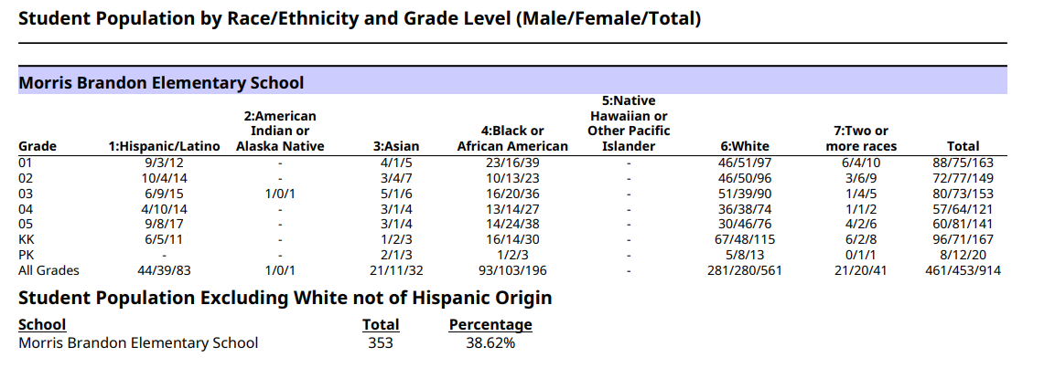
15 Day Enrollment Summary!

Slide 25
Principal’s
Update

Slide 26

APS
Personal Electronic Device
Policy
Notes:
The next two slides cover the Personal Electronic Device Policy

Slide 27
Starting this school year (2025–2026), students will be asked to keep their phones “up and away” during the school day.
Our Personal Electronic Device policy is a long-standing Board policy designed to support a focused, respectful, and distraction-free learning environment for everyone.
Additionally, next school year (2026–2027), in line with a new state law (HB340), this will expand to include other personal devices like smartwatches, tablets, and headphones.
APS
PED
Policy
Click the boxes below for the:
APS Board Policy
APS PED Regulation
Notes:
Principals: Please review the DISTRICT’s Personal Electronic Device Policy. (on the next slide, you will speak to how implementation looks in your school)

Slide 28
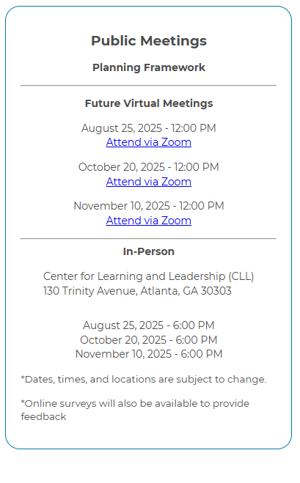
UPDATE
Comprehensive Long Range Facilities Plan
atlantapublicschools.us/APS2040
Notes:
Next on our agenda, we’d like to welcome our representative to the Long-Range Comprehensive Facilities Master Plan Taskforce. As many of you know, this taskforce plays a key role in shaping the future of our district’s facilities — ensuring they are aligned with projected enrollment, instructional needs, safety standards, and long-term community use."
Over the summer, the taskforce has been hard at work reviewing data, exploring options, and engaging in important planning conversations. [Name of Representative] will share an update on what’s been done so far, any key decisions or recommendations that have been made, and what’s ahead — including opportunities for the public to provide input.
[Allow the FMP representative to provide an update and answers questions. After this is concluded:]
Thank you [Name of Representative].
A report will be presented to the Board at its August 11 meeting, and the options will become public the week of August 18.
There are several upcoming public meetings where you can learn more and share your thoughts. The next public meetings are scheduled for: August 25, October 20, and November 10
On each date, there will be a virtual meeting at noon and an in-person meeting at the Central Office at 6PM.
I strongly encourage you all to attend these meetings. This is a critical time for public input, and your voice is essential.

Slide 29
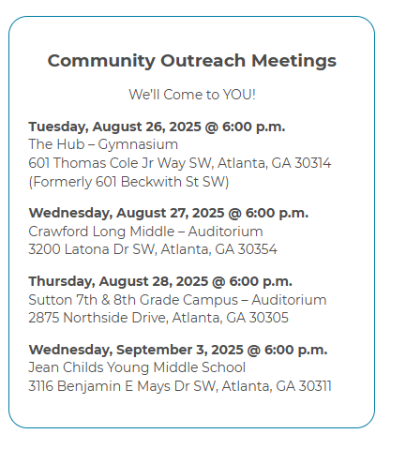
UPDATE
Comprehensive Long Range Facilities Plan
atlantapublicschools.us/APS2040
NEW OUTREACH MEETING WILL BE SCHEDULED FOR NA CLUSTER IN SEPTEMBER!
Notes:
Next on our agenda, we’d like to welcome our representative to the Long-Range Comprehensive Facilities Master Plan Taskforce. As many of you know, this taskforce plays a key role in shaping the future of our district’s facilities — ensuring they are aligned with projected enrollment, instructional needs, safety standards, and long-term community use."
Over the summer, the taskforce has been hard at work reviewing data, exploring options, and engaging in important planning conversations. [Name of Representative] will share an update on what’s been done so far, any key decisions or recommendations that have been made, and what’s ahead — including opportunities for the public to provide input.
[Allow the FMP representative to provide an update and answers questions. After this is concluded:]
Thank you [Name of Representative].
A report will be presented to the Board at its August 11 meeting, and the options will become public the week of August 18.
There are several upcoming public meetings where you can learn more and share your thoughts. The next public meetings are scheduled for: August 25, October 20, and November 10
On each date, there will be a virtual meeting at noon and an in-person meeting at the Central Office at 6PM.
I strongly encourage you all to attend these meetings. This is a critical time for public input, and your voice is essential.

Slide 30
Announcements
Notes:
Does anyone have any announcements? [Permit GO Team members to provide announcements, as appropriate.]

Slide 31
SAVE THE DATE
IN-PERSON
Bring the full GO Team
Come ready to collaborate, contribute, and create the future!
G3 Summit
Go.Grow.Govern.
Come learn more about:
Your school’s 2025-2030 Strategic Plan
Stakeholder Engagement
APS Forward 2040
…and much more
Saturday
September 27
8:30 AM – 2:30 PM
Notes:
Before we move on, I want to highlight an important upcoming event: the G3 Summit on Saturday, September 27.
We need as many GO Team members as possible to attend — this is a critical opportunity to come together, in person, and shape the future of our schools. Strategic planning for 2025–2030 is underway, and your voices, ideas, and leadership are essential.
You’ll be learning about your school’s new strategic plan, best practices for stakeholder engagement, and how this work connects to APS Forward 2040 — plus much more.
Please save the date and plan to attend! Come ready to collaborate, contribute, and create the future together.
More information will be coming soon.

Slide 32

GO Team Members
Remember to complete your training.
As outlined in Section 2.14 of the GO Team Handbook, GO Team members are required to complete orientation within one year of joining the team and must be renewed every four years.
Failure to complete this training will result in removal from the GO Team
Contact the GO Team Office if you have any questions.
Notes:
The GO Team Office would like to remind all GO Team members that they are required to complete orientation within one year of joining the team and must be renewed it every four years.
Failure to complete the orientation training will result in removal from the GO Team.
Please contact them if you have any questions.

Slide 33
THANK YOU
We’re looking forward to a great year!

